Slide 1

AMPLICAM WILDFIRE GUARDIAN
FOREST WILDFIRE DETECTION AND MONITORING SYSTEM
Armands Dīriņš
armands.dirins@amplicam.com
https://www.amplicam.com/
Notes:
1

Slide 2
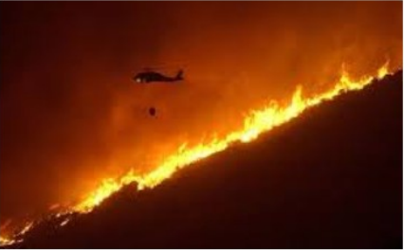
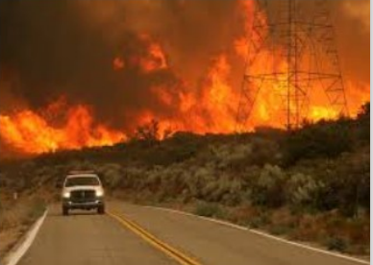
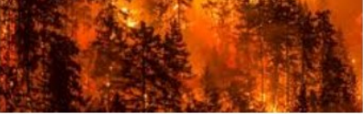
Climate change and human activity – main causes for increased wildfire
Air polution – CO2 emissions, up to 20-30% from World’s total
Damage to people’s properties, infrastructure
Destruction of wild life habitat, ecosystems
DANGER OF WILDFIRES
Notes:
2

Slide 3
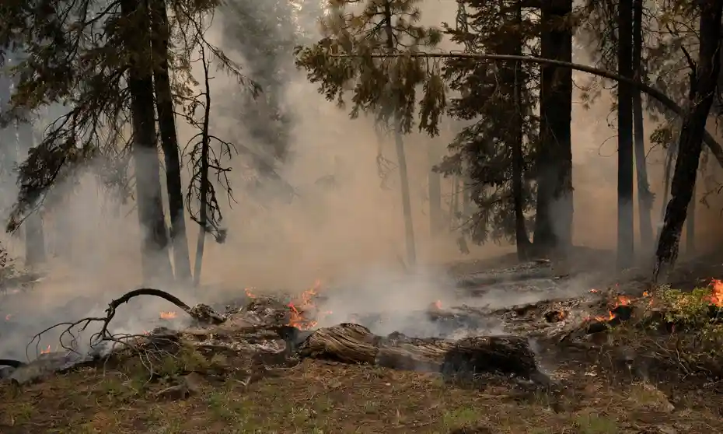
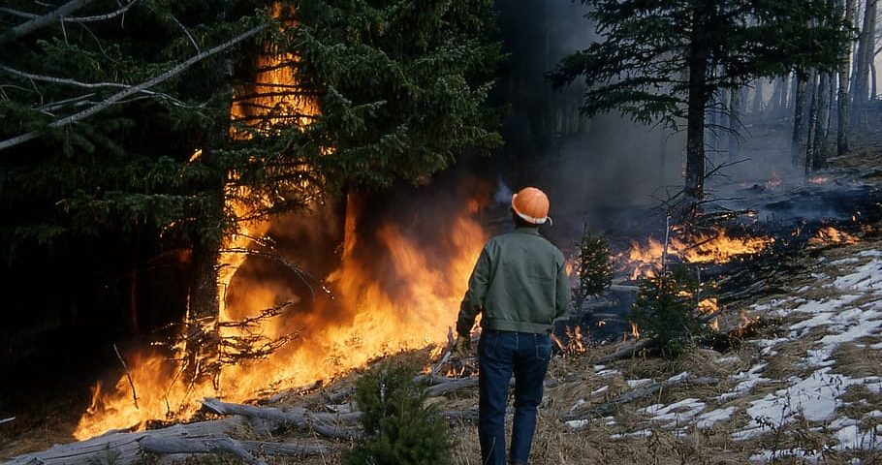
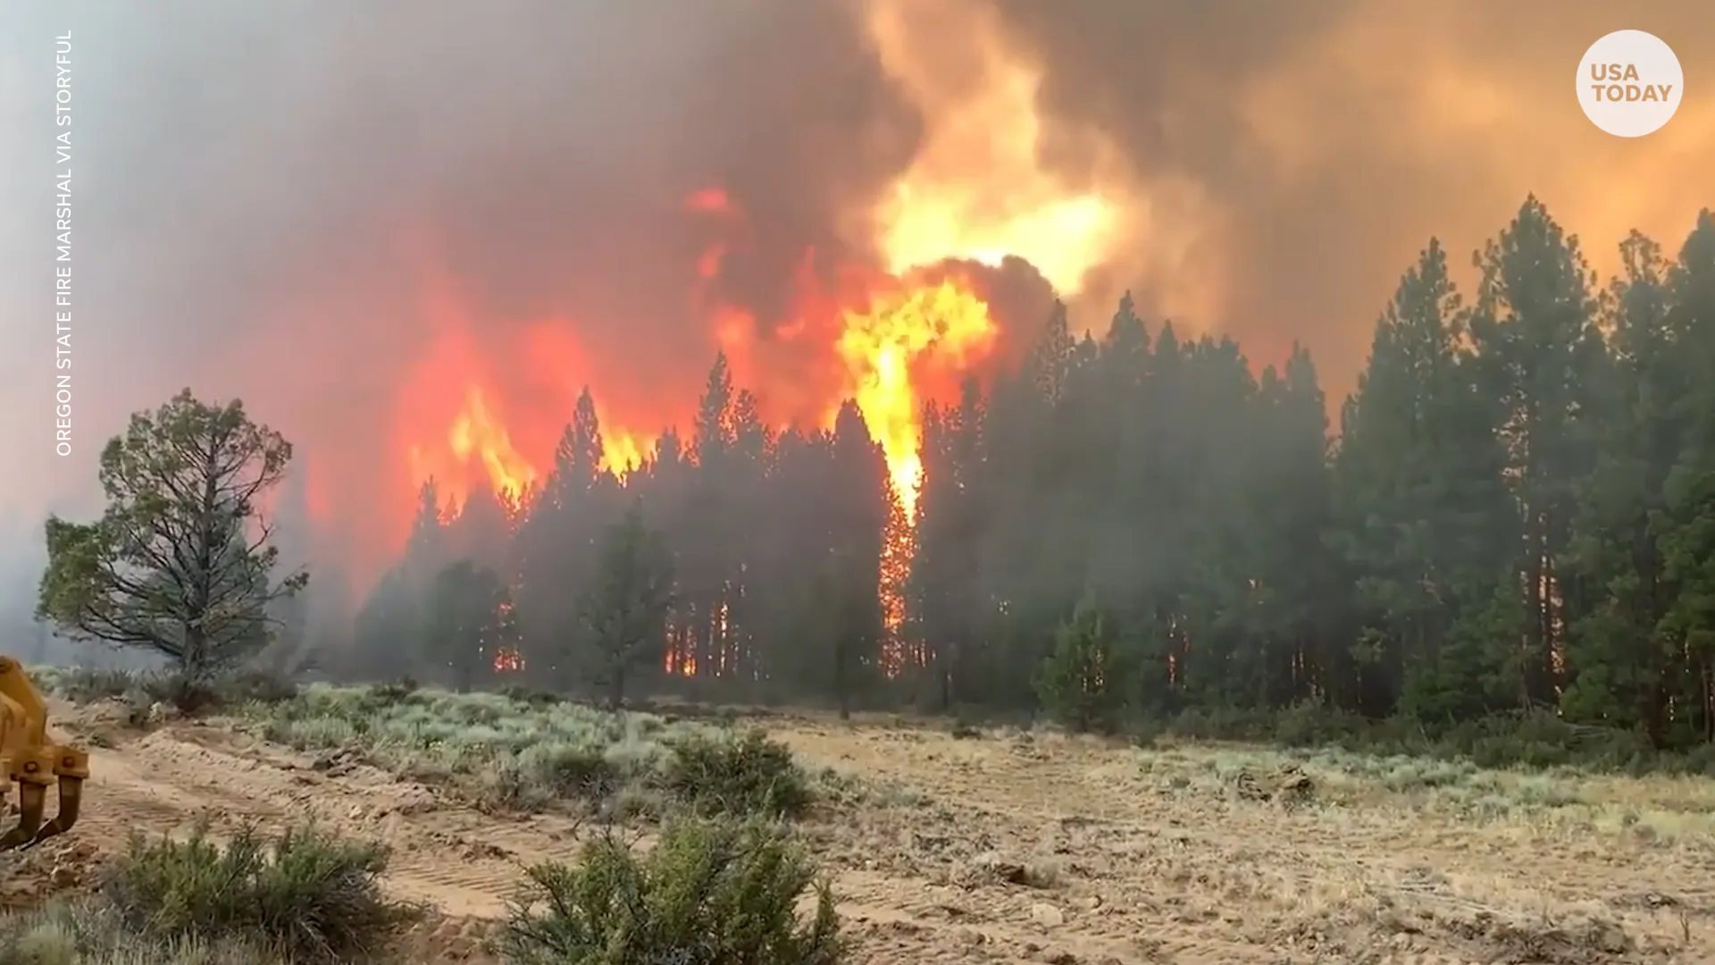
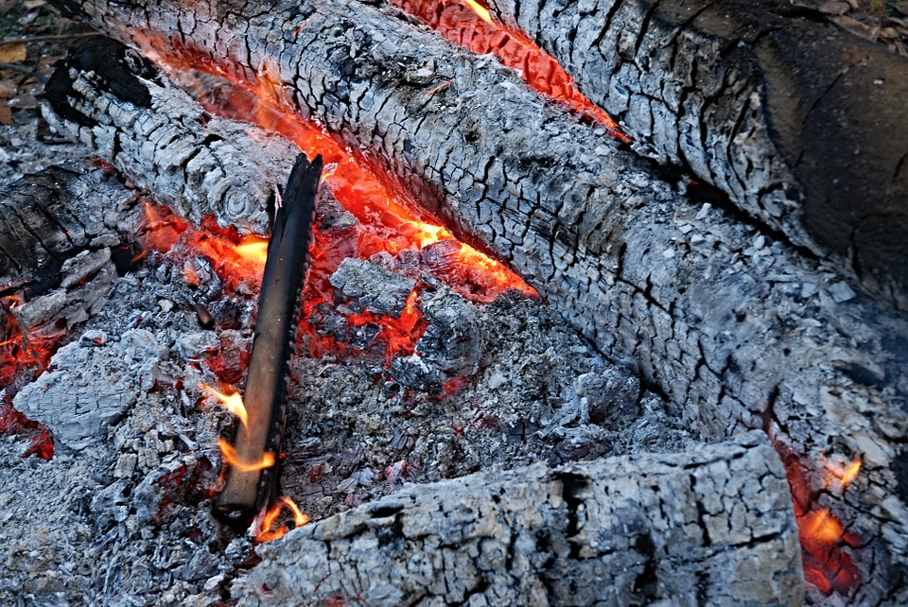
FOREST WILDFIRE
Incipient
(Pre-heat, Pre-flame)
Flashover
(Flaming)
Fully developed
(Transition)
Decay
Smoldering, gloving
Source: https://www.frontlinewildfire.com/the-four-stages-of-wildfire-combustion/
Notes:
3

Slide 4

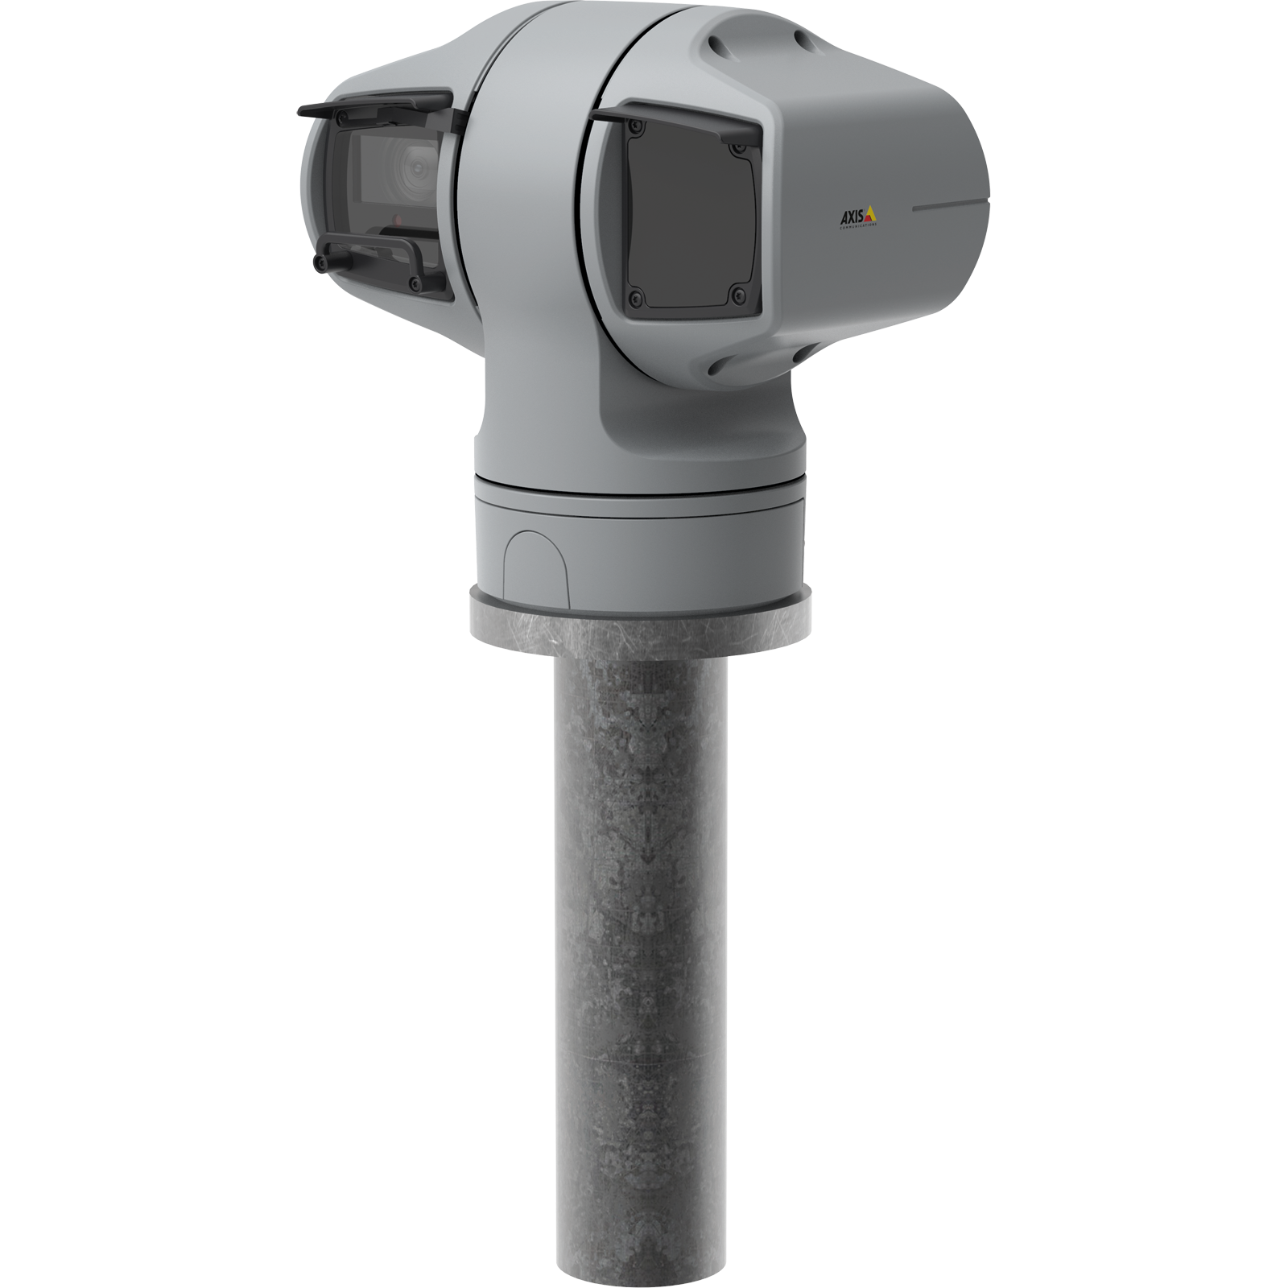


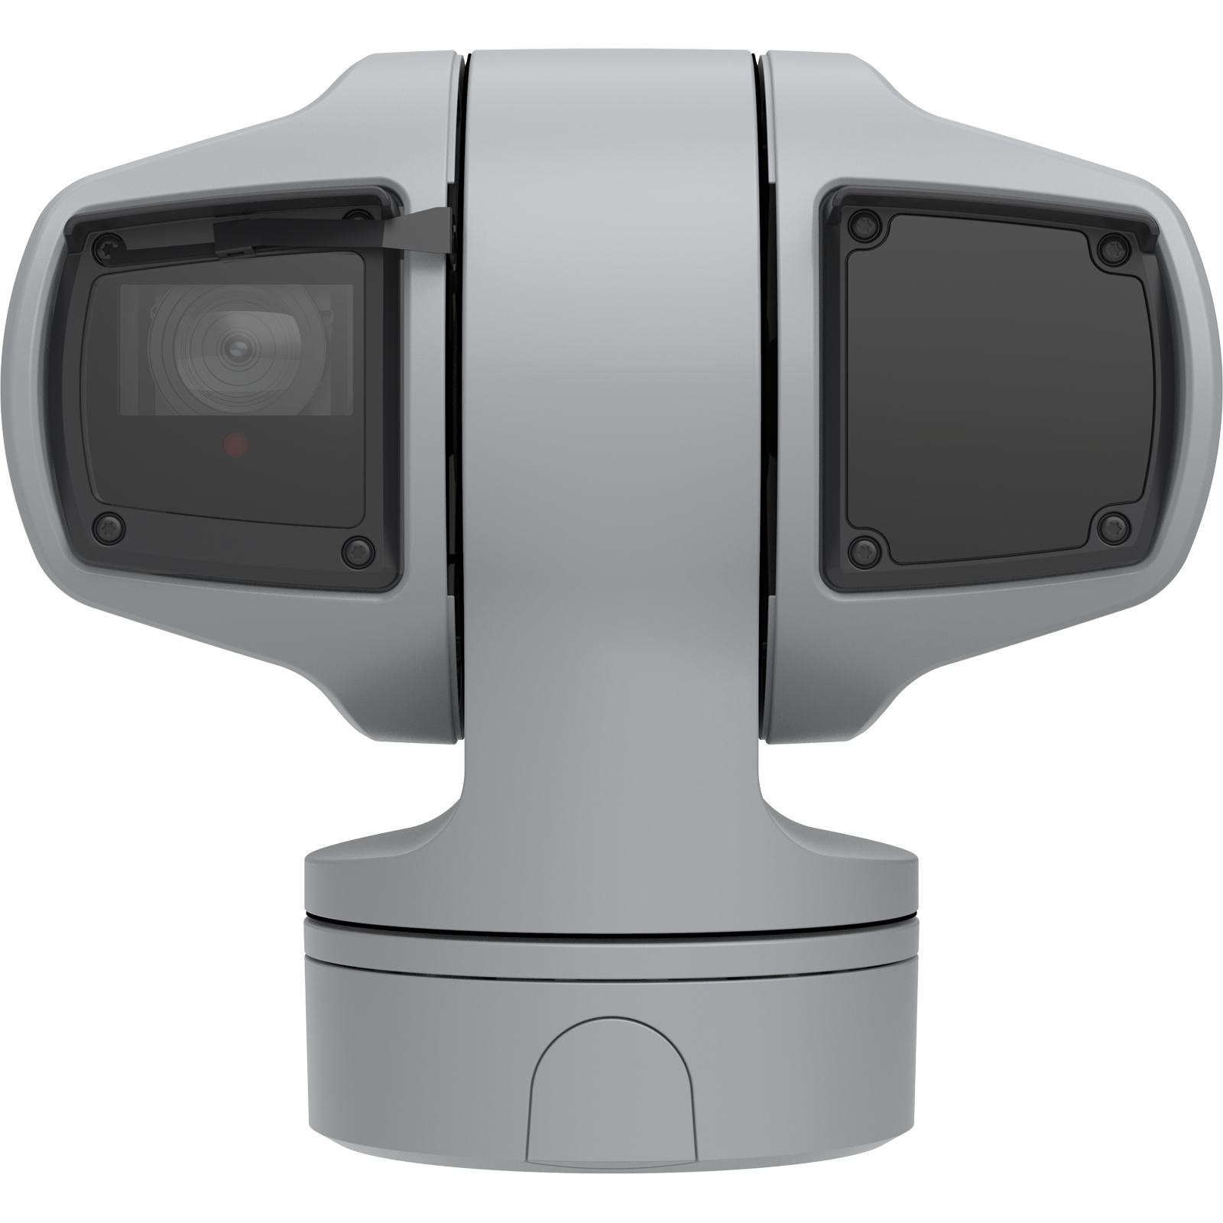
AMPLICAM – EARLY FOREST FIRE DETECTION
Network of connected commercial PTZ cameras
Mounted on high rised structures (40-70m)
Network connectivity:
2 ..5 Mbps/camera
Server and Analytics
GPU power required
Notes:
4

Slide 5
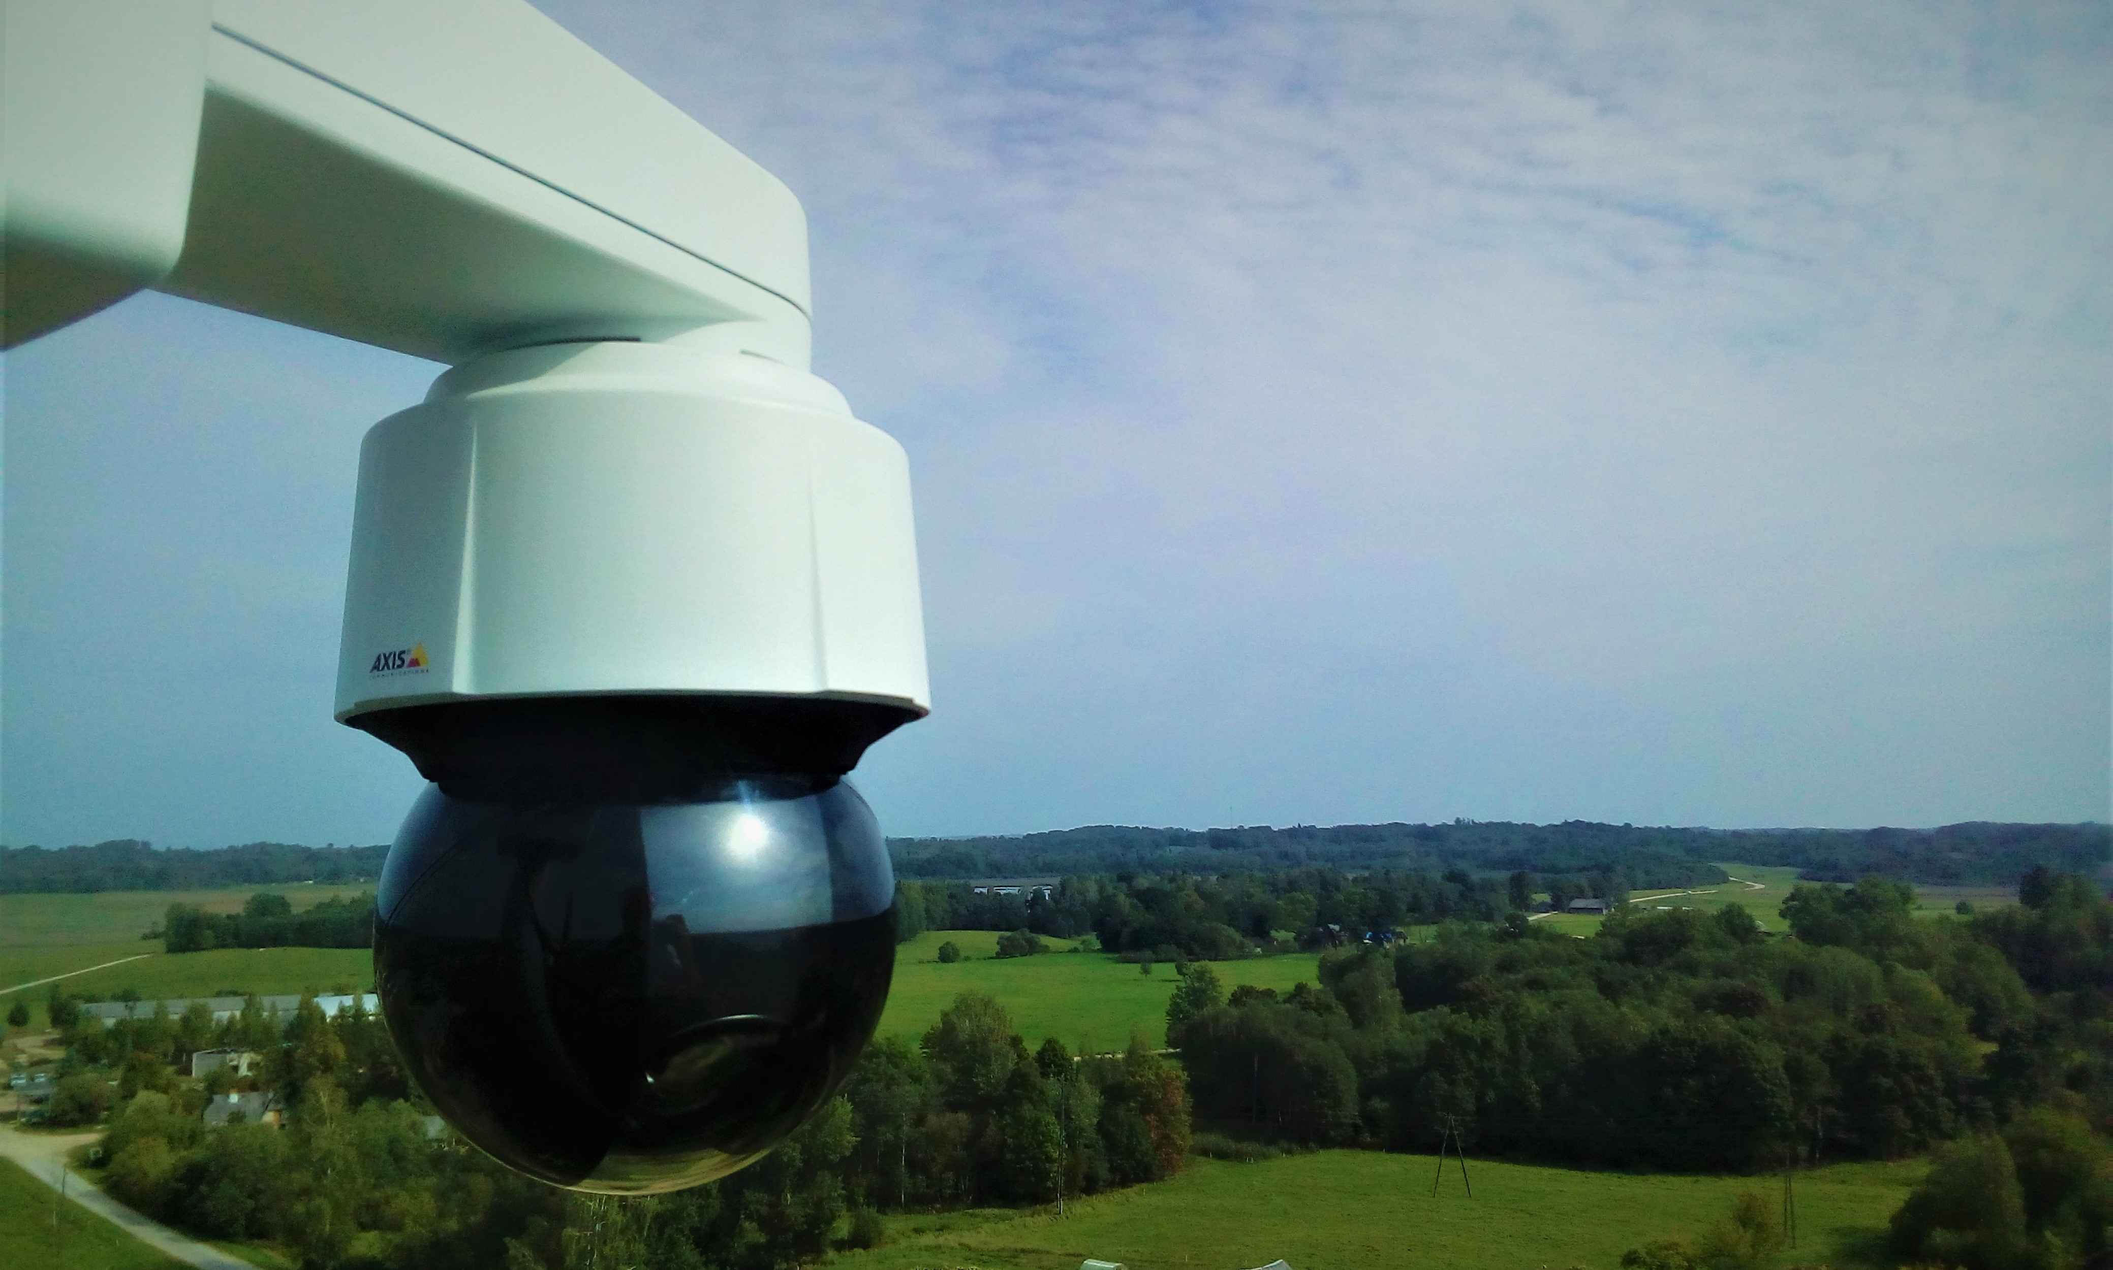
AMPLICAM WILDFIRE GUARDIAN
Based on network of commercially available video surveillance cameras (AXIS Q series PTZ cameras preferred)
Smoke/fire detector on cameras and server
Specialized software for centralized coordination, resource management and report generation, fully functional GIS
Customization and localisation
Notes:
5

Slide 6



HIGHLY SCALABLE SOLUTION
Global Server
(optional)
- Global DB
- Web server
Regional servers
20 cameras
50 cameras
100 cameras
300 cameras
Regional control room
Videowall
Operator work place
User access
Web browser
Notes:
6

Slide 7
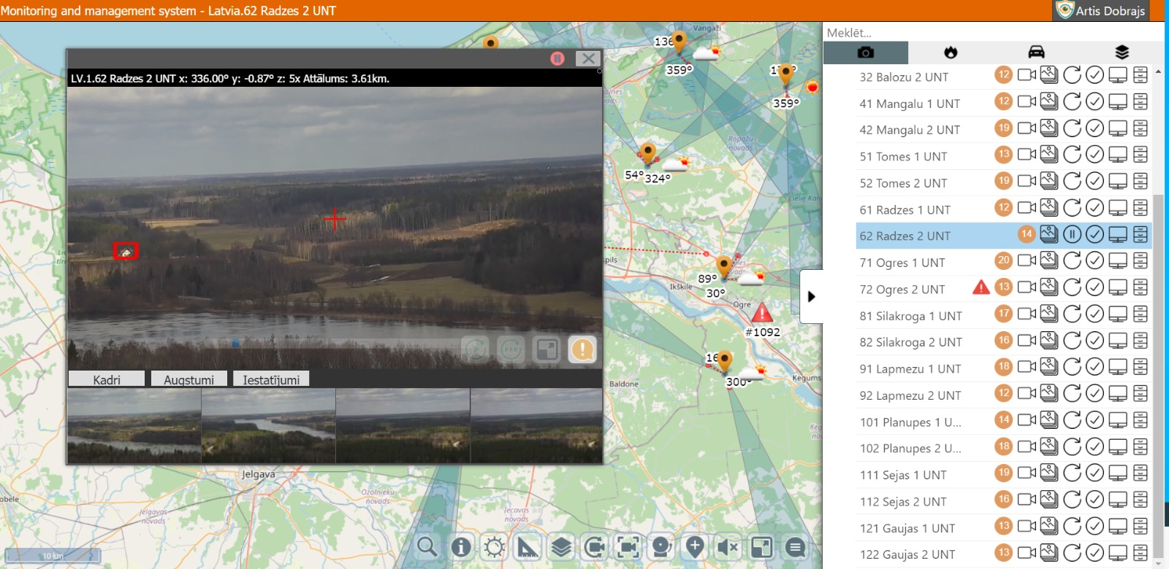
Notes:
7

Slide 8
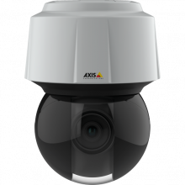
BENEFITS OF EARLY FIRE DETECTION
Increased fire detection speed and accuracy
  Efficient use of personnel - one operator can monitor up to 35 cameras
  Reduced burn out area by 40%
  Average fire extinguishing time reduced 3 times
Notes:
8

Slide 9
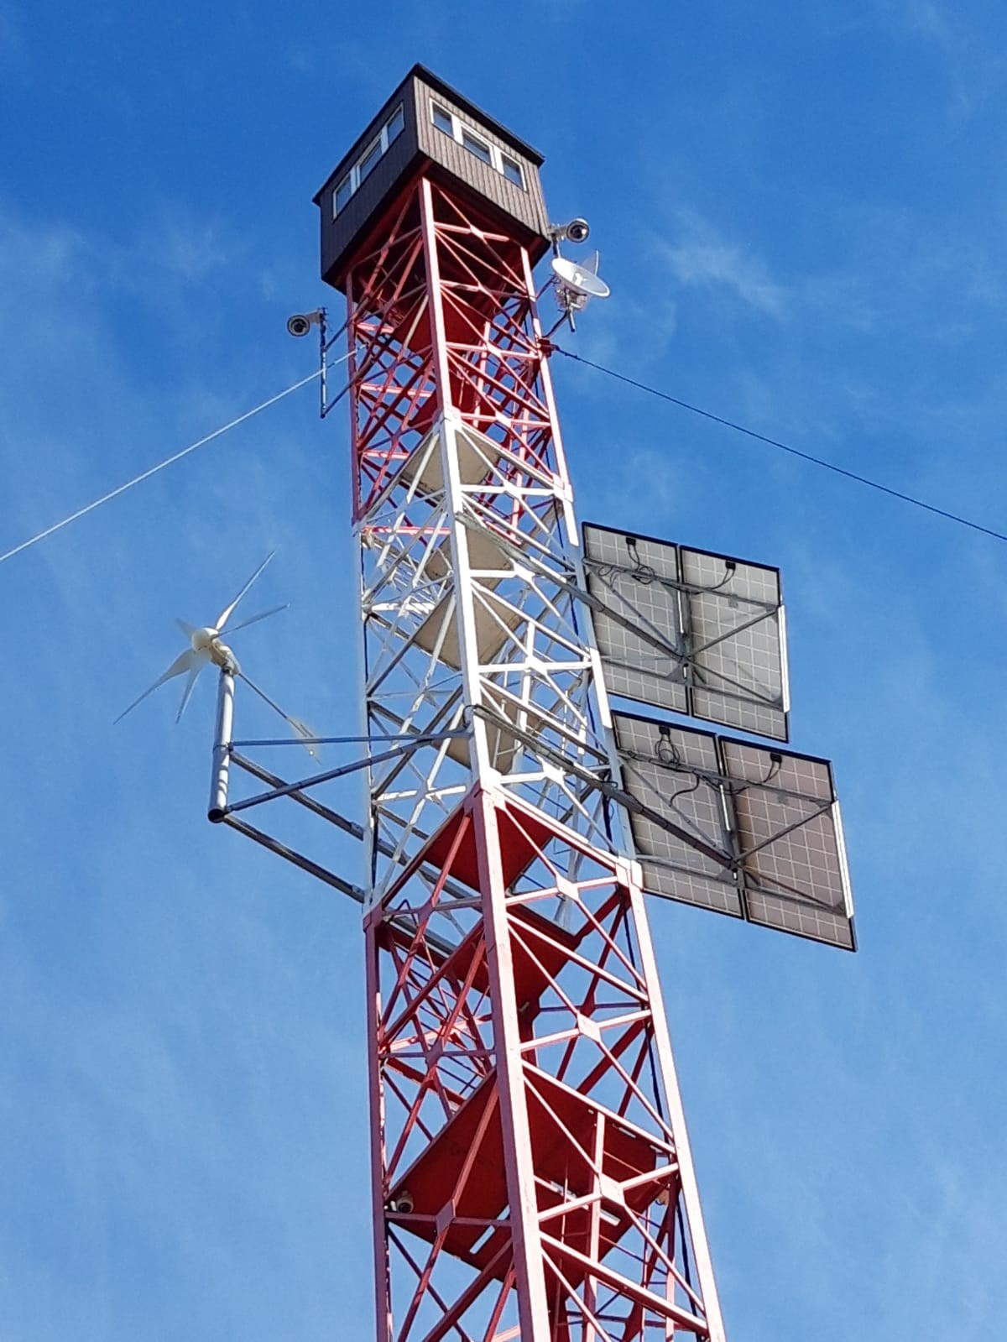
AMPLICAM
AXIS technology integration partner References State Forest Service (Latvia)
Natural Resources Canada WMDS (South Africa)
Notes:
9

Slide 10
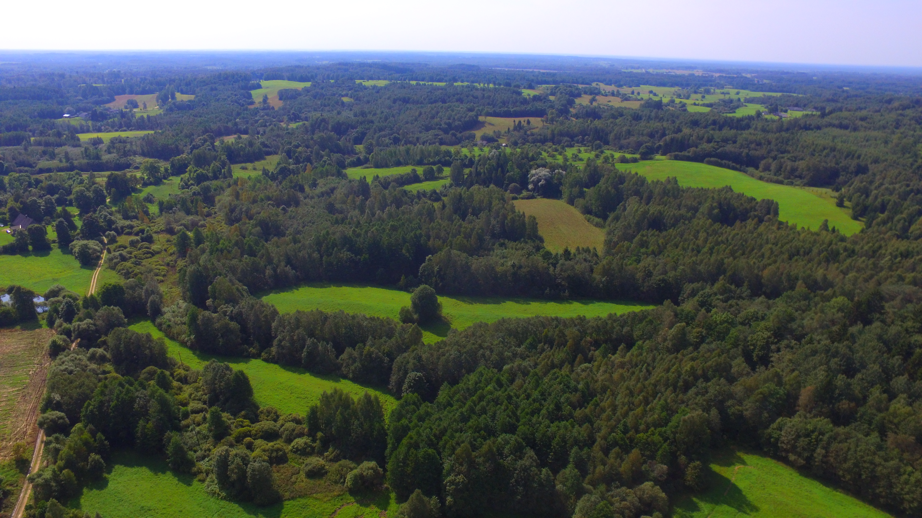


Notes:
10

Slide 11
RESOURCES
Web
https://www.amplicam.com/
Linkedin
https://www.linkedin.com/company/amplicam/
Youtube
https://www.youtube.com/watch?v=j-fQc1ZeHJg
BOOK A DEMO!
Notes:
11

