Slide 1
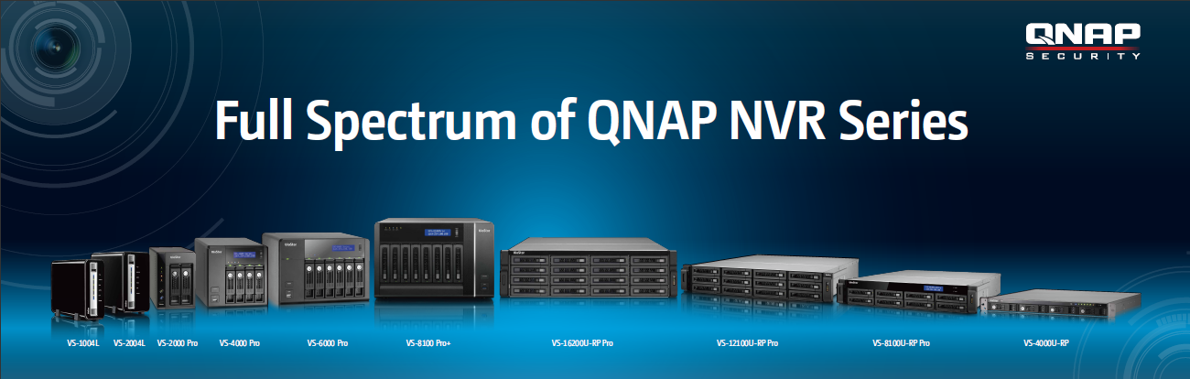
QNAP Global Market Position & Competitive Strength
By: Alvin Wu
www.qnapsecurity.com

Slide 2

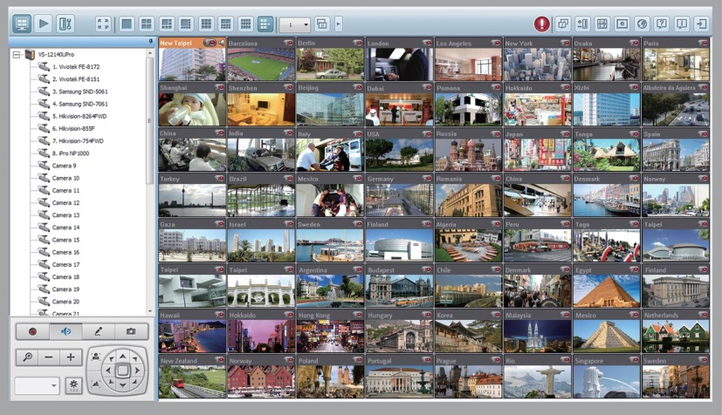
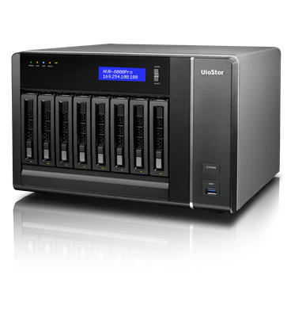
QNAP VioStor NVR
Network Video Recorders
Notes:
2

Slide 3
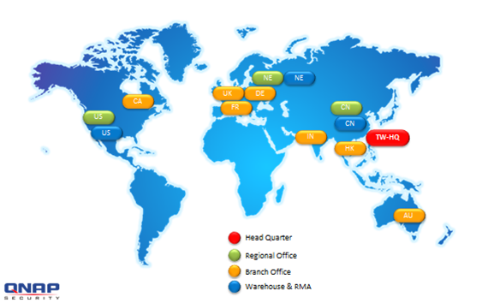
About QNAP
Notes:
QNAP is a worldwide storage brand from Taiwan& our main business is NAS( Network attached storage) which is a storage product.
We are RD- orientated company and 50% of our employees are engineers, because we focus on producing good and stable product instead of fancy marketing.
Since NAS development is getting mature, we use this technology to innovate VioStor NVR& we merge a company which produce digital signage& video wall.
We will increase this solution into NVR product line in the near future.

Slide 4
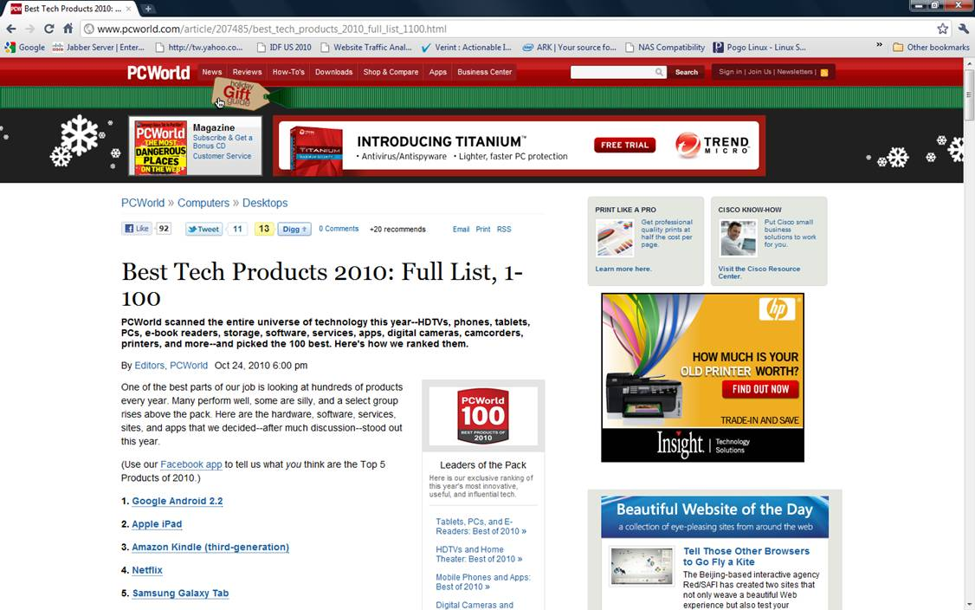
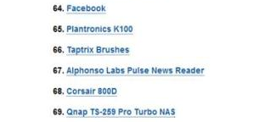
QNAP NAS:
Best Tech Products 2010 - PC World
QNAP NAS is the only storage device on the list !!!
Notes:
For the SMB NAS, we are the top 3 in the world.
Our outstanding product has been reported by PC world as the top 100 high-tech product. Apple, Android market and facebook are one of the product been reported& QNAP NVR is the only Storage company which is reported.

Slide 5
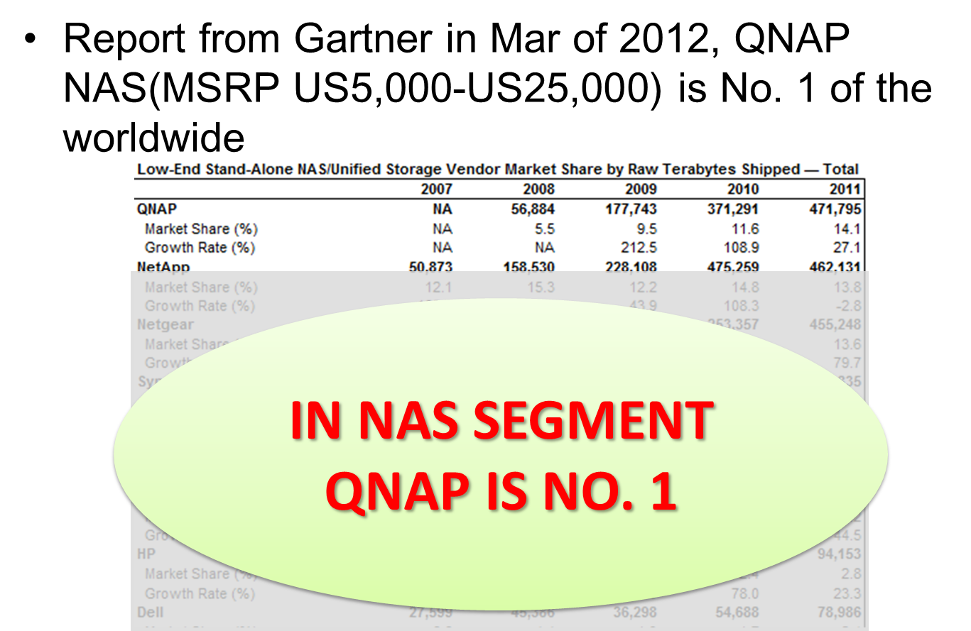
QNAP NAS: Top 1 of Worldwide
Low-end Standalone NAS/Unified Storage Vendor Market Share by Unit Shipments – Total Gartner (March 2012)

Slide 6
QNAP NVR: Top 10 Player of Embedded NVRs
QNAP VioStor NVR MIT Embedded NVR
Market Shares for Embedded NVRs
2009Top Ten Product Worldwide
2009 Revenues = $167.8 million Source: IMS Research
Geutebrueck
14.0%
Honeywell
5.9%
Sony
3.0%
NICE System
13.0%
Pelco
4.7%
QNAP
2.7%
Panasonic (PSS)
8.3%
Vicon
3.6%
IndigoVision
7.3%
Hitachi Kikusai
3.3%
Notes:
QNAP NVR is not software based and we focus on embedded NVR solution.
After being approved by market, we are in top 10 player in this field.
We believe we will definitely going up, because we have the core knowledge of network and storage which are the most important factors of an outstanding back-end.

Slide 7




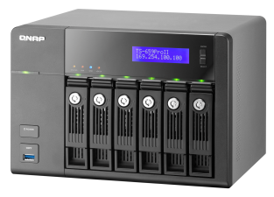
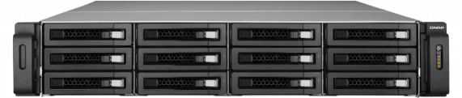

















About QNAP Awards
QNAP VioStor NVR Awards worldwide
InfoWorld's 2012 Technology of the Year Award winners
NVR Excellence Awards in 2012 Secutech Awards Contest
NVR Excellence Awards in 2013 Secutech Awards Contest
VS-12164URP Pro
TS-659 Pro II

Slide 8
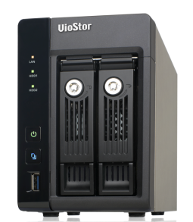
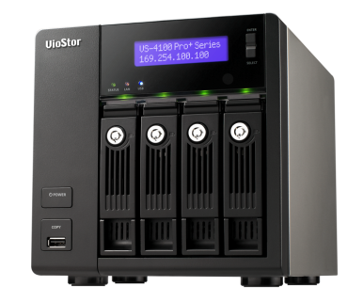
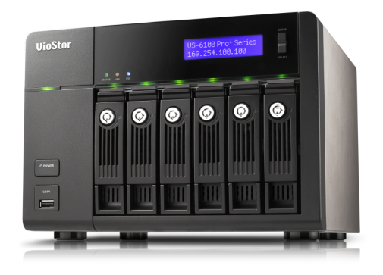
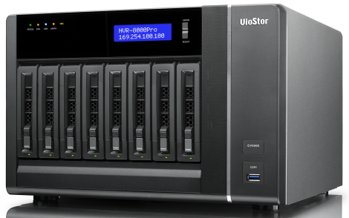
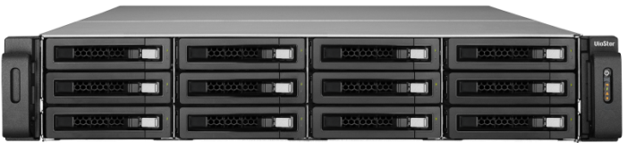
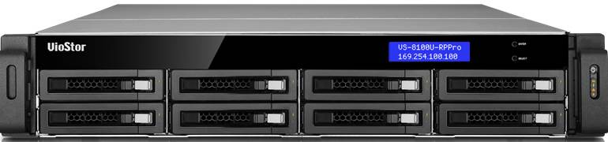
2. Why QNAP VioStor NVR?
Notes:
8

Slide 9
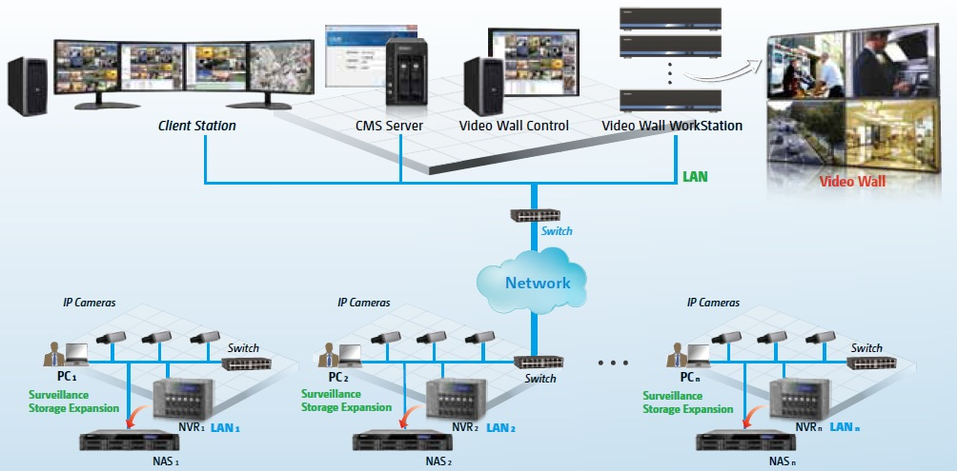
QNAP Surveillance Solution

Slide 10
Hold Key Technologies of Turnkey Solution
QNAP VioStor NVR
Reliable Turnkey standalone NVR Supplier
Integration
Software
Hardware
Notes:
QNAP NVR is only produce Standalone NVR which we also call “turnkey solution”.
Most important keys of the turnkey are “hardware”, “software”All in one~ of course “integration”will be the key to optimizing system.
QNAP complete these 3 important tasks by ourselves to ensure optimizing system!!
We use industry-level hardware, stable OS, integrate& test cameras in our labs.
Since we strictly control every details, we are confident that QNAP can offer the most reliable turnkey solution to you.
10

Slide 11

Comparative Benefit of Standalone & PC Base
 | VioStor NVR | PC-based Solution
OS | Linux Embedded | Windows
Stability | High | Low
Setup cost | Low | High (+ PC)
Ease of setup & management | Easy, only simple steps | Difficult (Software required)
System temperature | Low | High
Maintenance (frequency) | Low (easy-to-maintain) | High
System crash risk | Low | High
Problem analysis | Easy (by event logs) | Difficult
Auto power on when power recovery | Yes | No, manual reboot required
Virus attack/Trojan threaten | None | Sometimes
Power consumption and noise level | Low | High
Total maintenance cost | Low | High
Notes:
QNAP VioStor NVR is Linux Embedded system. why do we choose this OS, because Linux system is more stable and without the risky of virus attach.
Also, when you first time to install our system, we have a 6-step guideline to lead you how to finish all the settings.
Comparing with PC based, you need to build a PC, install a software, make sure all the software is not conflicting… The installation procedure will be usually longer and more complicated.
If you are using QNAP VioStor NVR. Those chaos will be solved. Also, our system can do the problem analysis by system logs which can help you identify the root cause easier! Overall maintenance cost will be lower for sure.

Slide 12




Practical Test& Proof HDD Compatibility
QNAP VioStor NVR
Integrate with the latest and biggest storage capacity HDD.
Take the lead to support 4TB HDD
Compatible with varied HDD brands (http://www.qnapsecurity.com/pro_compatibility.asp)
Recommend HDDs are all past stress test in our lab.
Notes:
Recommend HDDs are 通過壓力實測驗證串流傳輸、影像錄影及各種RAID功能, 確保NVR的可靠度

Slide 13


Solid Network camera Integration Tech
QNAP VioStor NVR
High compatibility with most major brands on the market consistently

Slide 14




Industrial level hardware
QNAP VioStor NVR
Intel embedded platform
Intuitional LED Indicators shows NVR’s network Status, LAN, USB, Power, HDD connection status
Dual Gigabit LAN ports can support network failover, Loading balance and Dual IP settings
Intelligent Auto Power on after Power Recovery
UPS Support for 24/7 service

Slide 15
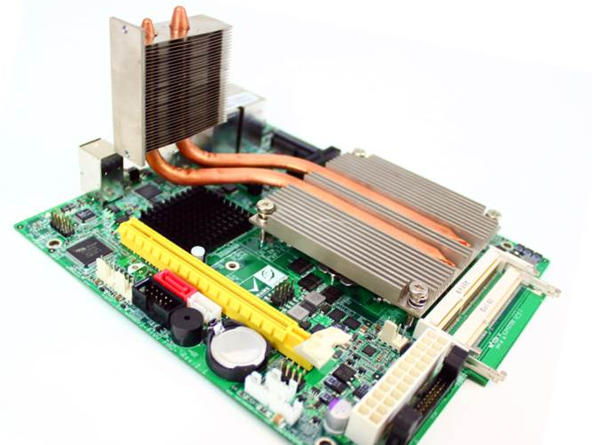
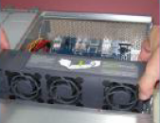
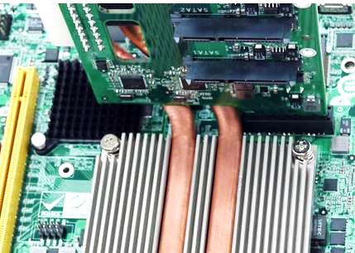
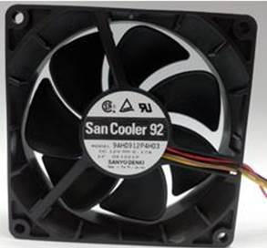
Industrial level hardware
QNAP VioStor NVR
1.
2.
3.
CPU Thermal Solution with Fan-less Design
Hot-swappable SATA hard drives with cable-less design
Easy-hot-swappable fan module for 12-bay NVR
Build-in Japanese Sanyodenki system fan for 4-bay/ 6-bay Tower
4.
Notes:
Note:
Lower failure rate
100% inspection in Sanyodenki production line

Slide 16


Reliable Storage Solution
QNAP VioStor NVR
Advanced RAID with Hot-swap Design
The VioStor NVR supports RAID 0, 1, 5, 6, 5+hot spare, single, and JBOD disk configurations. Its hot-swap design allows a failed drive of a disk volume (RAID 1 or above) to be replaced by hot swapping without turning off the server.
Online RAID Capacity Expansion
Online RAID Level Migration
Notes:
Advanced RAID with Hot-swap Design The VioStor NVR supports RAID 0, 1, 5, 6, 5+hot spare, single, and JBOD disk configurations. Its hot-swap design allows a failed drive of a disk volume (RAID 1 or above) to be replaced by hot swapping without turning off the server.
Online RAID Capacity Expansion and Online RAID Level Migration
Online RAID Capacity Expansion The storage capacity of a RAID configuration can be expanded by replacing the hard drives with larger ones. All the data will be kept and seamlessly moved to the newly installed hard drives. There is no need to turn off the server during the process.
Online RAID Level Migration Upgrade the disk configuration to a higher RAID level with the data retained without turning off the server.

Slide 17

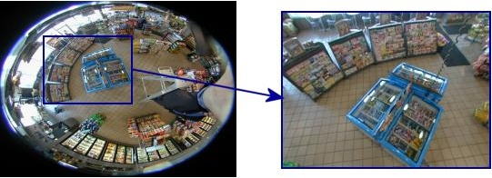
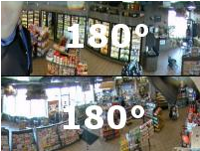
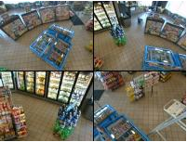






Remote Monitoring
Multiple browser support
Support Dual screen mode
Each screen support Max. 64-channel display mode
Support dewap fisheye cameras and immervision lenses
Dynamic E-map

Slide 18
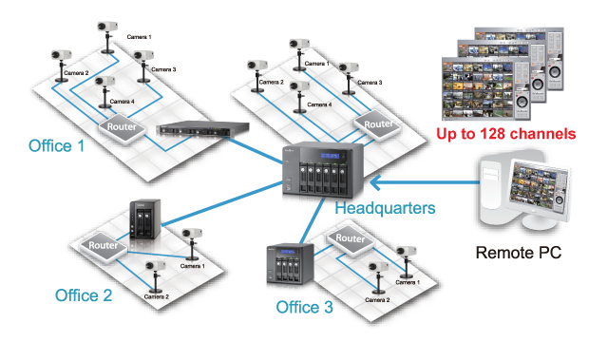
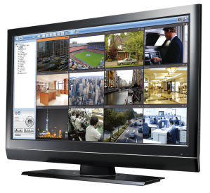
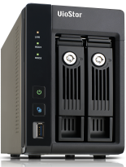
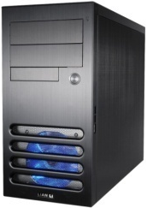
Remote Monitoring
No additional software required!
Multi-server monitoring
enables simultaneous monitoring of up to 128 ch
HTTPS secured connection
HTTP
WAN
/ LAN
HTTPS
Notes:
QNAP的NVR系統, 支援HTTPS的安全傳輸協定, 可以增強遠端連線時的傳輸影像安全性。

Slide 19

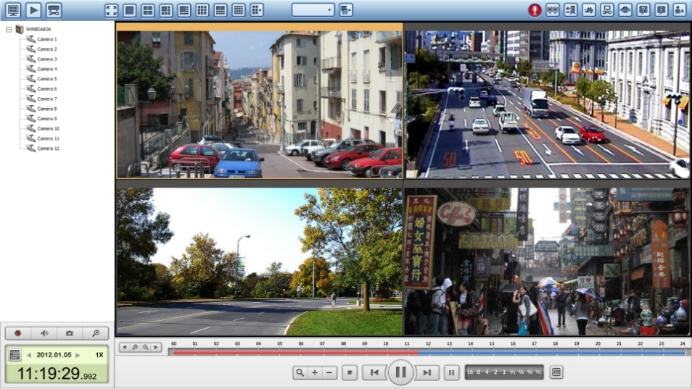


Remote Playback
Playback supports up to Full HD resolution.
Simultaneous playback up to 16 channels
A channel (IVA) intelligent video analytics search.
Digital watermark export

Slide 20

Advanced Event Management
-
Events
Camera Event: Motion detection, alarm input, connection failure
NVR Event: Recording failure
Actions
External Event: User-defined event
User-defined action
SMS and email alert
PTZ camera control, alarm output
Multi-channel recording, NVR buzzer
Notes:
PC-less network surveillance by HD (high definition) HDMI or VGA Local Display
Multi-server monitoring enables simultaneous monitoring of up to 128 IP cameras (This software is bundled with NVR & no extra charge)
Quick playback of up to 16 channels at the same time with intelligent video analytics like motion detection, missing object, foreign object, out of focus and camera occlusion.
Advanced Event Management helps to initiate various actions when an event is triggered, such as multi-channel recording, navigating a PTZ camera to a preset position, activating a buzzer, sending text message, email or sending a command to other security systems via the alarm output.

Slide 21
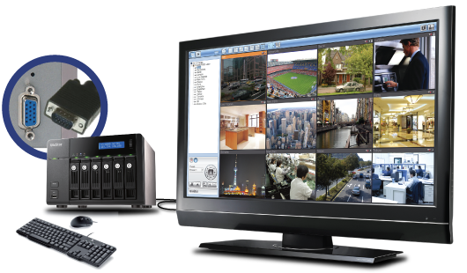
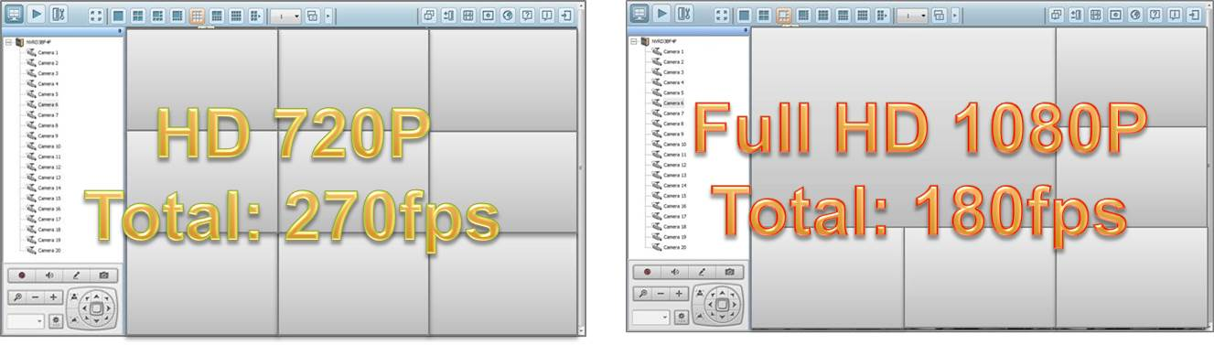
Local Display
QNAP VioStor NVR
PC-less network surveillance by HD (high definition) HDMI or VGA Local Display
All you need is a USB mouse!
USB keyboard (optional)
Live-view up to 16ch
Single channel playback
local Export video
Fundamental Network and camera configuration
Live Monitoring

Slide 22




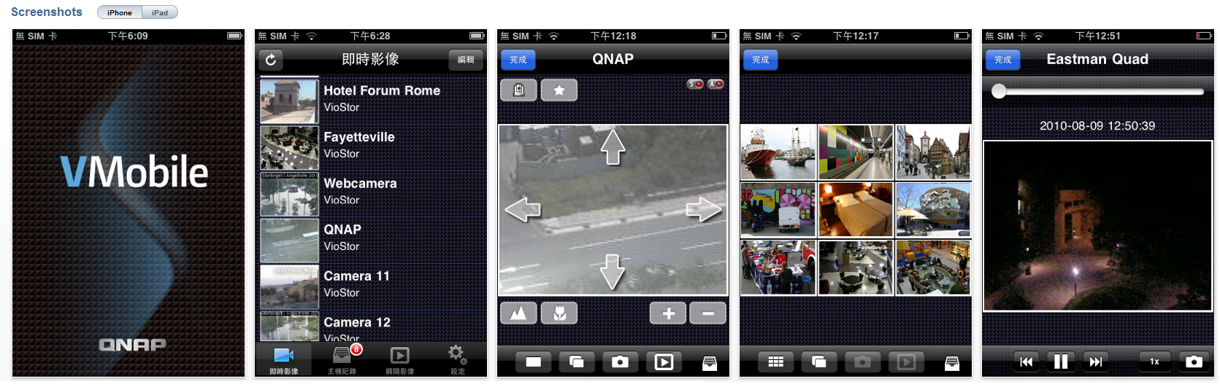
Mobile Surveillance
QNAP VioStor NVR
Live monitoring with the VMobile app
- iPhone, iPad, iPod touch
- Android Phone and tablet
- Windows PDA
Notes:
All our apps are free!!

Slide 23
3. Product Line Overview
Notes:
23

Slide 24
Naming Rule of QNAP VioStor NVR
VS
8
0
48
U
RP
Pro+
Number of channels supported (recording)
Product type
VS: VioStor
Rack mount H/W design
Redundant power supply
CPU platform
(Pro+ ) Local display by HDMI monitor
(Pro ) Local display by VGA monitor
(L) Without local display interface
Tray numbers of hard disk
Our Product Line

Slide 25
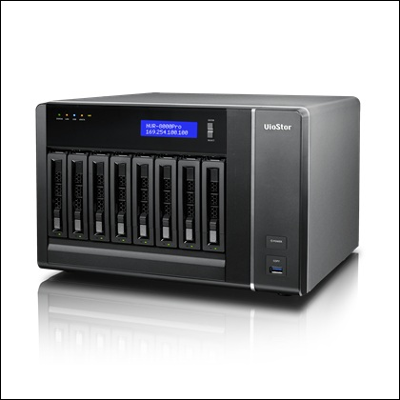
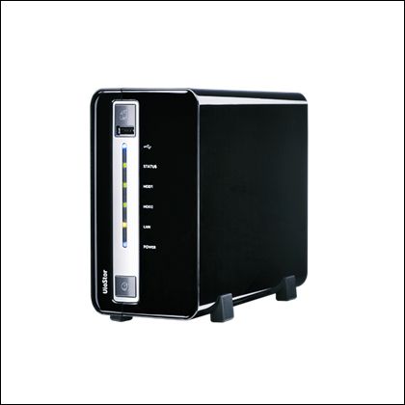
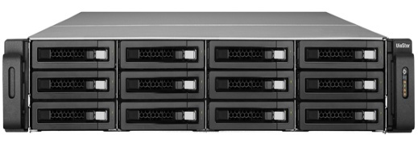
Overview of our recorders
QNAP VioStor NVR innovative standalone NVRs with the same user friendly system.
Name depends on the number of hard disks and IP channels and divided into 3 types:
Rack Mount
Tower
Lite
Product Line Overview

Slide 26
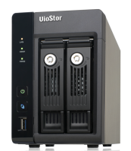
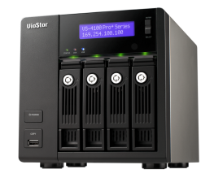
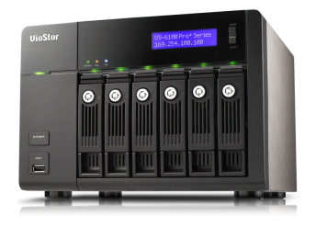


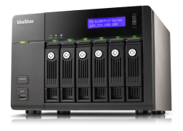
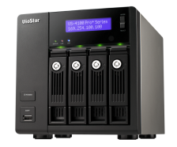
TOWER
Hot Swapable
2 Giga LAN port
UPS supported
 | VioStor Model | Max. CH | Max. HDD# | Local Display | Audio Input /Output | Total Throughput
 | VS-8148 Pro+ VS-8140 Pro+ VS-8132 Pro+ VS-8124 Pro+ | 48 40 32 24 | 8 | HDMI | N/A | 400Mbps
 | VS-6120 Pro+ VS-6116 Pro+ VS-6112 Pro+ | 20 16 12 | 6 | HDMI | Yes | 330Mbps
 | VS-4116 Pro+ VS-4112 Pro+ VS-4108 Pro+ | 16 12 8 | 4 | HDMI | Yes | 250Mbps
 | VS-2112 Pro+ VS-2108 Pro+ VS-2104 Pro+ | 12 8 4 | 2 | HDMI | Yes | 180Mbps

Slide 27
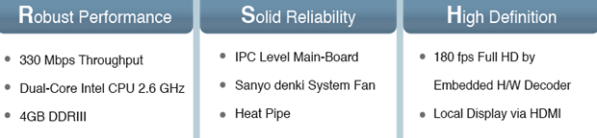
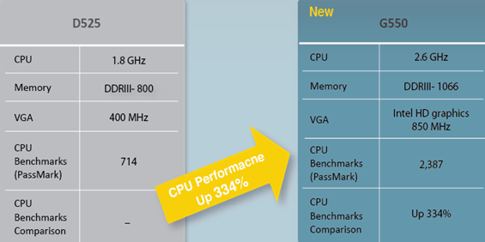
TOWER

Slide 28
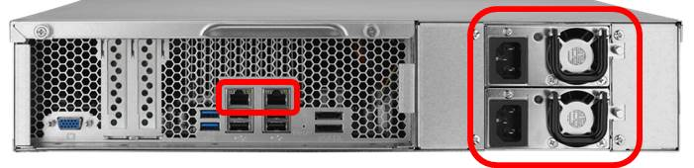
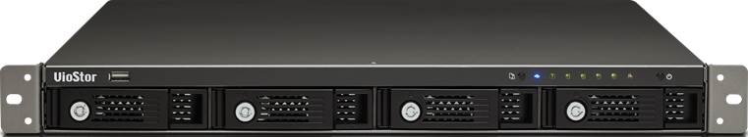
Rack mount
Hot Swappable
UPS supported
Redundant power
VioStor Model | Max. CH | Max. HDD# | Local Display | Giga Lan Port # | Total Throughput
VS-12164U-RP-Pro+ VS-12156U-RP-Pro+ VS-12148U-RP-Pro+ VS-12140U-RP Pro+ | 64 56 48 40 | 12 | HDMI/ VGA | 4 | 450Mbps
VS-8148U-RP Pro+ VS-8140U-RP Pro+ VS-8132U-RP Pro+ VS-8124U-RP Pro+ | 48 40 32 24 | 4 | HDMI/ VGA | 4 | 400Mpbs
VS-4116U-RP Pro+ VS-4112U-RP Pro+ VS-4108U-RP Pro+ | 16 12 8 | 4 | HDMI | 2 | 250Mbps

Slide 29

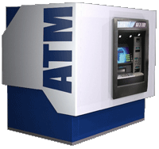

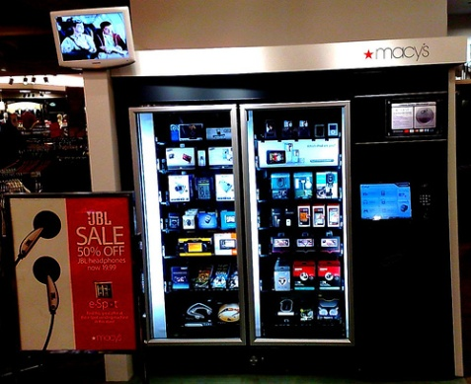
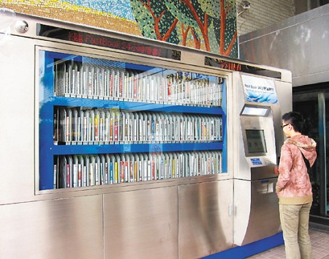
Lite Version
Outdoor ATM Machine
VioStor Model | Max. CH | Max. HDD# | Total Throughput
VS-2008L VS-2004L | 8 4 | 2 | 28Mbps
Self-Service Vending Machine

Slide 30


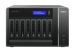






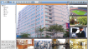
Full Spectrum NVR Series
 | 2-bay | 4-bay | 6-bay | 8-bay | 12-bay
64ch
56ch
48ch
40ch
32ch
24ch
20ch
16ch
12ch
8ch
4ch
VS-12164U-RP Pro+
VS-12156U-RP Pro+
VS-8148 Pro+
VS-8148U-RP Pro+
VS-12148U-RP Pro+
VS-8140 Pro+
VS-8140U-RP Pro+
VS-12140U-RP Pro+
VS-8132 Pro+
VS-8132U-RP Pro+
VS-8124 Pro+
VS-8124U-RP Pro+
VS-6120 Pro+
■ Intel® Ivy Bridge processor
■ Intel® Core™ i3 processor, 4GB DDR3 RAM
■ Dual-core Intel 2.6GHz processor, 4GB DDR3 RAM
■ Marvell 2.0 GHz CPU, 1GB DDR3 RAM
VS-4116 Pro+
VS-4116U-RP Pro+
VS-6116 Pro+
VS-2112 Pro+
VS-4112 Pro+
VS-4112U-RP Pro+
VS-6112 Pro+
VS-2108L
VS-2108 Pro+
VS-4108 Pro+
VS-4108U-RP Pro+
VS-2104L
VS-2104 Pro+
Notes:
This is the over-view of our product roadmap

Slide 31
4. In the near future
Notes:
31

Slide 32
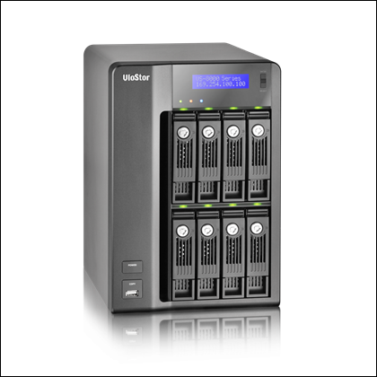
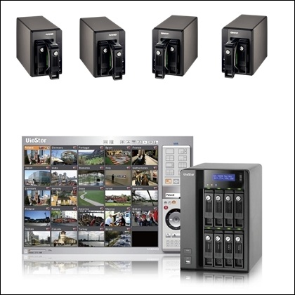
1-1. NAS Expansion
Official support at FW4.1.0
Expanding our NVR storage
With further integration between QNAP’s two core technologies, a limitless storage expansion for all NVRs will be made possible by adding multiple NAS servers to the surveillance network. In the times of the storage consuming megapixel recording, only QNAP will be able to provide sufficient and expandable storage capability at one stop.
In the near future
Notes:
Besides hardware update, we will support Single NVR expend the storage capacity to multiple NAS.
This solution can support your hotel, bank or government project which request to record several months or a year.
(Here is the concept of NAS Expansion <<Jump to the next page>>

Slide 33

1-2.NAS Expansion
In the near future
Notes:
how many channel which the NVR can support is the number of NAS which you can expend to.

Slide 34


2. Smart Recording
Official support at FW4.1.0
When event is occurred, VioStor NVR switch to Megapixel or high fps recording
Benefit: Save plenty of storage capacity and only record the important moment which had event trigger
In the near future
Notes:
Edge recording is an important feature to make sure the whole video clips is complete when there is an unknown disconnection between camera and QNAP NVR.
This function will merge the video which is recording at camera SD card during the disconnection and store those video into QNAP NVR.
Thus, when user playback videos , they can playback complete videos.

Slide 35


3. Edge Recording
Official support at FW4.1.0
Diagram is from Axis
New possibilities for flexible and reliable recording solutions- Edge storage (failover recording). QNAP VioStor NVR will support seamless video clips, although camera loses connection with the NVR . Lost videos will be automatically saved in QNAP NVR when camera get connection with NVR again.
In the near future
Notes:
Edge recording is an important feature to make sure the whole video clips is complete when there is an unknown disconnection between camera and QNAP NVR.
This function will merge the video which is recording at camera SD card during the disconnection and store those video into QNAP NVR.
Thus, when user playback videos , they can playback complete videos.

Slide 36

4. Two-way audio
Official support at FW4.1.0
Speaker enables two-way voice communication between the network camera and a PC/ QNAP NVR used to monitor the camera image. In addition to conventional monitoring of images and sound, voice messages can be transmitted from the PC/QNAP NVR to the network camera.
In the near future
Notes:
Two-way audio is one of camera functions. This function will be activated soon. Then, user can monitor and send voice messages for quick reaction.

Slide 37

5-1. CMS
2013, August
QNAP VioStor CMS
Expanding horizons, going beyond
Notes:
The Latest CMS server will be launched at the end of April. This CMS server can manage up to 1024 channels. When you have bigger scale projects, we will be able to support your requirment.

Slide 38

5-2. CMS
2013, August
QNAP VioStor CMS
Authentic client-server architecture
Dashboard for system overview
User-friendly GUI, Raise the work efficiency.
Flexible user defined live video & E-map monitoring layout diversity
Multi-layer Emap for flexible viewing
Role-based permissions and user management
Support Megapixel monitoring and playback videos
Notes:
The Latest CMS server will be launched at the end of April. This CMS server can manage up to 1024 channels. When you have bigger scale projects, we will be able to support your requirment.

Slide 39
5. Success Stories
Notes:
39

Slide 40

Success Story – Gasoline Station in India
BPCL owns around 40,000 petrol stations throughout India.
Every day, there are so many customers coming to the stations for services, and the operation of fuel services is frequent among people on site.
QNAP® VioStor NVR VS-2008 Pro has successfully turned BPCL surveillance system into an advanced network appliance and structure, and effectively helped BPCL with the large-scale surveillance tasks for better environment monitoring and improved employee and customer security at the different petrol stations in the country.

Slide 41






Success Story
International School
Convenience Store Chain
Large Office
Multi-functional Shopping Center
Chain Stores

Slide 42







Success Story
Production & Assembling Plant
Cultural Center
Resort

Slide 43
6. Conclusion
Notes:
43

Slide 44
QNAP Advantage
QNAP VioStor
World Class Storage company provide NVR.
The reliability of Hardware proved by NAS
Full spectrum of the standalone turnkey NVR
Advanced Local Display of Standalone Linux-Base NVR
(Cost effective/ user-friendly UI/ steady system)
Support 12-bay NVR with higher recording storage capacity.
The integration of IP Camera is fast & solidly
NAS surveillance storage expansion: Strategy position
Notes:
* Storage technology is the key to make a reliable NVR
That is why many DVR makers still can not make a good NVR yet

Slide 45



Scalable Management Capability
Comparing Items | Local Display | Multi-Server View (free CMS) | CMS-2000
Number of Channels Supported (Live View) | 64 | 128 | 64-1024
Maximum Channels in a Layout | 16 | 64 | 64
Number of Monitors Supported | 1 | 2 | 4
Number of User Accounts | 1 | 32 | Unlimited
Applicable Site Size | Small Scale Sites (1-64 CH) | Medium Scale Sites (64-128 CH) | Large Multi-Site (64-1024 CH)
Key Feature | Flexibility of Deployment | Remote Monitoring | Privilege Management

Slide 46
Thank you!!
Notes:
46

