Slide 1
Presenter: Elena Yu
Title: Company Profile
Date: 10 Jan 2014

Slide 2
About the company
Core Value
Current Product Line
New Product, New Solution for Full HD IP Camera
Safety Certificate
Scalable, systematic video surveillance application
Business Alliance Partner

Slide 3
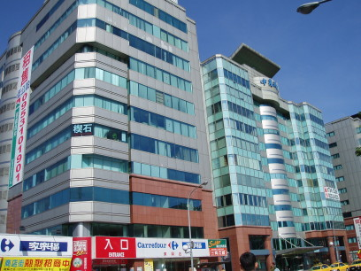
About the company
Founded
President
Location
2007
Gordon Chen
Taipei City , Taiwan
Product aim for:
Embedded Network Video Recorder
PC Network Video Recorder Software
Central Management System Software
Video Decoder
Intelligent Video Technology

Slide 4
About the company
Core Value
Current Product Line
New Product, New Solution for Full HD IP Camera
Safety Certificate
Scalable, systematic video surveillance application
Business Alliance Partner

Slide 5


Core Value: RD Strengths
Audio/video
codec
Multi-media
Database
Optimization for DSP
strengths
Linux
Windows
Platform
Software Framework Design
Multimedia communication
Protocol
Intelligent Video Analytic

Slide 6
Core Value: Connecting the digital vision
●Years of experience and research
● Specialize in digital image processing and IP protocol
● High performance and maximize image quality
●Tailor-made and cost-effective
● Seamless integration and quick future upgrade
● Open platform and modular software architecture
Openness
Expansion
Simplicity
Software
Solution
Service
●Customer-oriented
● Long term partnership
● Win-Win business relationship

Slide 7
About the company
Core Value
Current Product Line
New Product, New Solution for Full HD IP Camera
Safety Certificate
Scalable, systematic video surveillance application
Business Alliance Partner

Slide 8

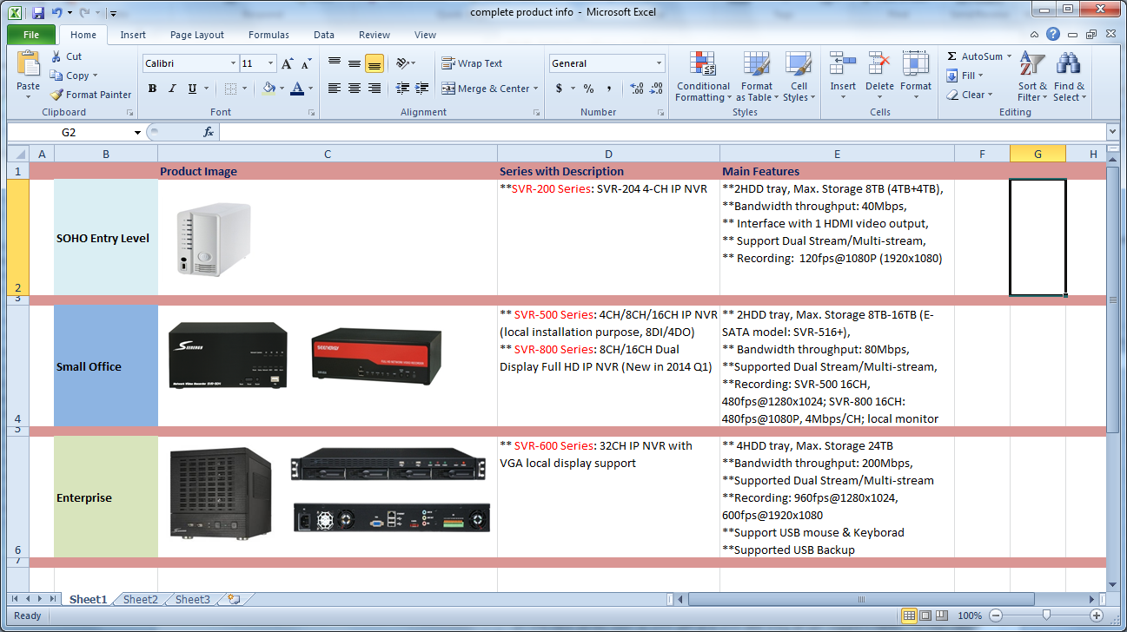
Current Product Line
IP surveillance software
Network Video Recorder
Central Management System
Backup Server
IP surveillance embedded system

Slide 9
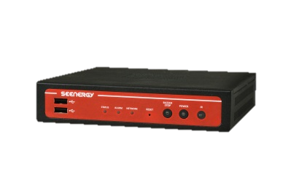
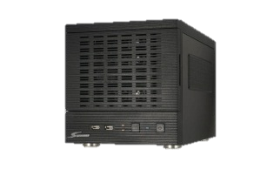
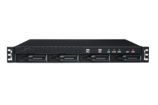
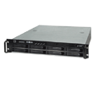
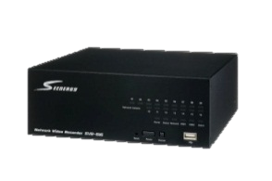
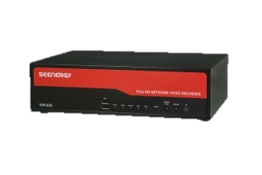

NVR Solution
Central Management-Pi-Vu central
Remote Backup-Pi-Vu Smart Backup
Mobile Access-Mobile Viewer
Video Decoder-SVD-832
NVR Server
NVR with Local Display
SVR-632:32CH, 4 bay
SVR-632U:32CH, 4 bay
SVR-632S:32CH, 8 bay
Enterprise
SVR-504:4CH
SVR-508:8CH
SVR-516:16CH
SVR-516+: 16CH & RAID0/1
SVR-808:8CH
SVR-816:16CH
SVR-816+: 16CH & RAID0/1
SVR-816U: 16CH, 4 bay, RAID0/1/5
Small office
Entry
level
SVR-204

Slide 10

IP surveillance software
Network Video Recorder
Central Management System
Backup Server

Slide 11

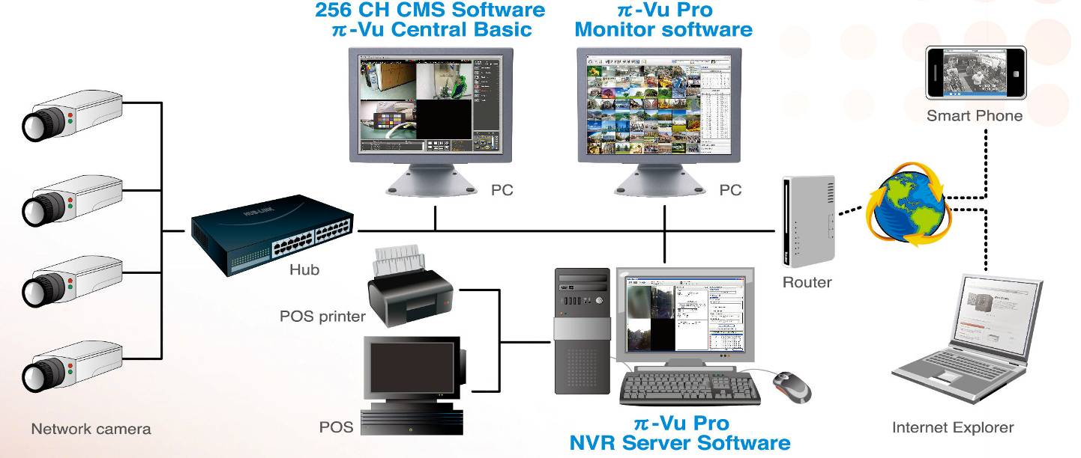
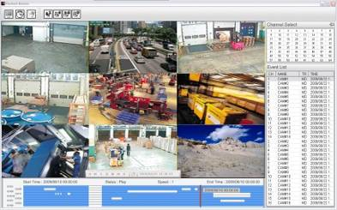
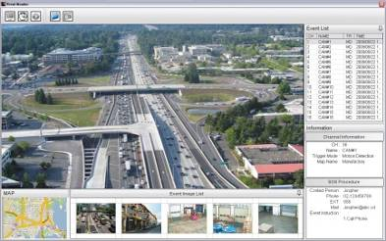
NVR Server Software Pi-Vu Pro
‧ Built-in Video Analytic
-Smart Video Motion detection
-Active Tampering Alarm
-Object Loss Detection
-Tripwire
-Object counting, face counting
‧ Intelligent video configuration tool
‧ Built-in Image Enhancement tools
‧ Live and Playback Hybrid Display
‧ Support 256CH CMS software
‧ Client-server Architecture
‧ Manage up to 64 Network Cameras
‧ Support MJPEG/MPEG4/H.264
‧ Support 5 Mega Resolution
‧ Support Camera event (MD,DI/DO)
‧ Advanced E-Map Monitoring
‧ Remote Client Backup and Playback
‧ Two-way Audio
‧ Built-in Web server
‧ Dual stream
‧ Support POS

Slide 12
NVR Server Software Pi-Vu Pro Lite

Slide 13
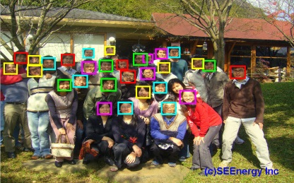
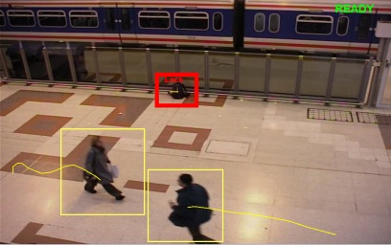
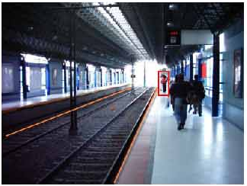
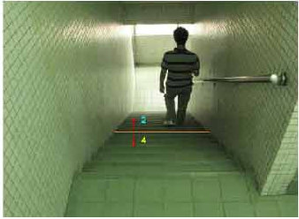
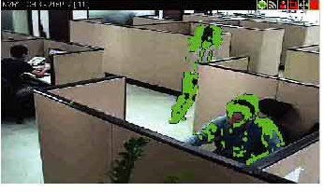
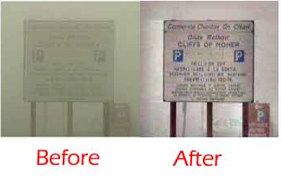
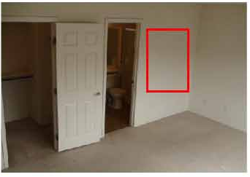

Intelligent Video Analysis
Object loss detection
Smart motion detection
Camera tempering detection
Tripwire
Object Counting
Image Enhancement
Face detection
(Face counting)
Foreign detection

Slide 14
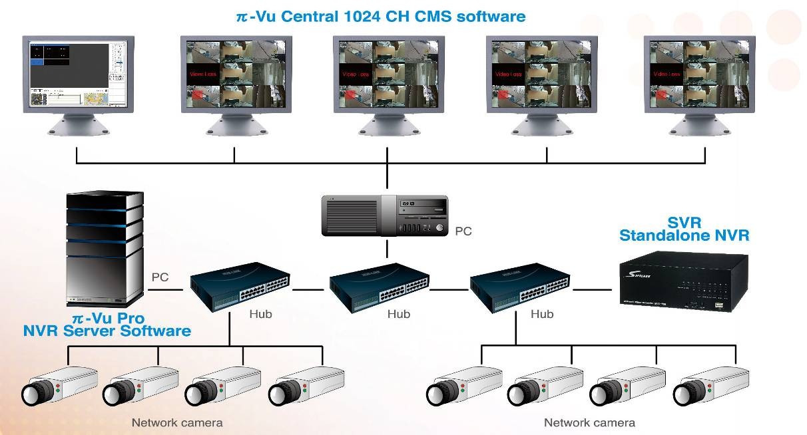
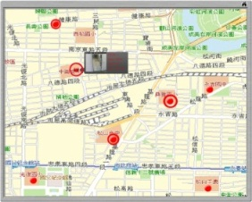
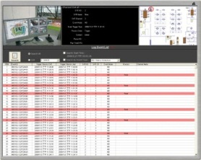
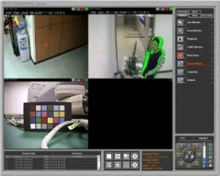
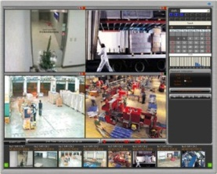
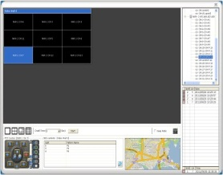
CMS software Pi-Vu Central
‧ Central management of 1024 NVRs
‧ Support Maximum 1024 channels
‧ Two way audio
‧ Smart Motion Detection, Tripwire,
camera tampering detection,
Object loss detection,
image enhancement
‧ Device Smart Detection
‧ Multi-screen Management
‧ Picture-in-picture E-Map Monitor
‧ Flexible Video Screen Assignment
‧ Mouse-over-video PTZ Control
‧ Support multi-monitors
‧ 4 Layers E-Map
‧ Video wall
-1 console monitor+4 full screen monitors)
-full screen: 1x1, 2x2, 3x3

Slide 15

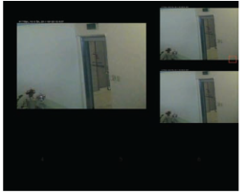
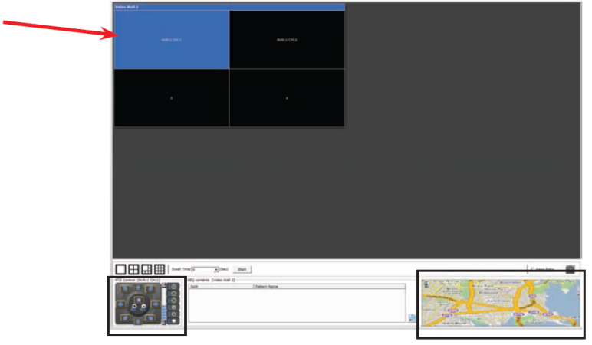
Pi-Vu Central Video Wall
Main monitor displays
the Console
The main monitor will be used to display the console
for operations, and the VideoWalls are assigned to
additional monitors (max. 4, one VideoWall/monitor)
The Console only display view layout, the videos are
displayed on the VideoWalls.
Additional monitor
displays the selected
VideoWall

Slide 16
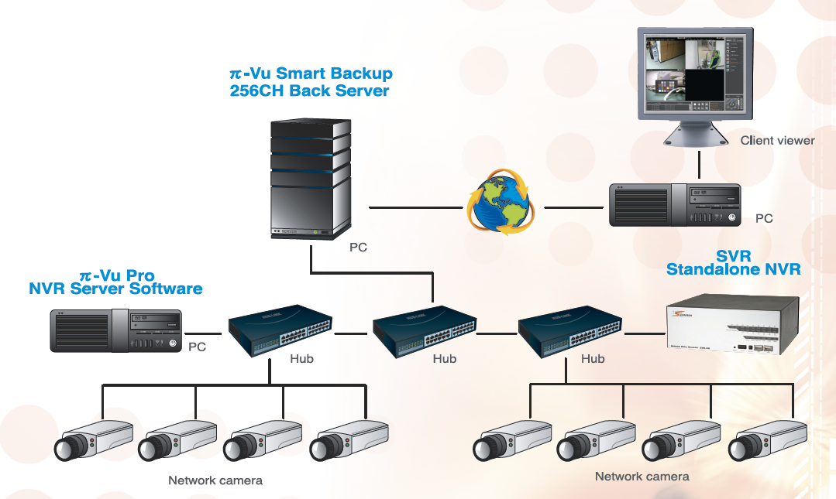
Backup server software Pi-Vu Smart Backup
‧ Backup Media data/event log from multiple
servers (Pi-Vu Pro/SVR) at same time
‧ Support Maximum 256 channels
‧ Support different backup Frequency: Hr/
Day/Week/Month.
‧ Support different frame rate setting in
different time.
‧ Manual backup for a specific period for a
specific channel
‧ Specify the network bandwidth for backup
Support auto adjust bandwidth
‧ Provide remote viewer program to playback
(by time, by event)
‧Delete the backup data. (by time, by size)
‧ Support export of media backup.
‧ USB Key pro for license protection

Slide 17

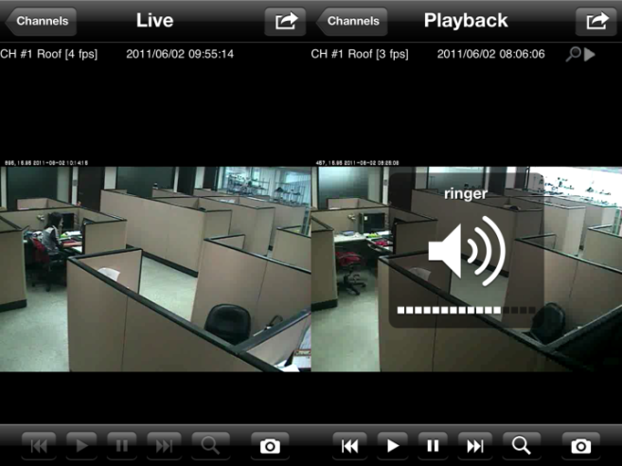
iPhone/iPad/Android APP NVR Mobile Viewer
‧Auto Search NVRs on the Network
‧Support MJPEG/MPEG4/H.264
‧Support audio
‧Unlimited NVR Access
‧Support digital PTZ
‧Live and Playback
‧Playback search by time/event
‧Support Portait and Landscape View
‧JPEG snapshot

Slide 18
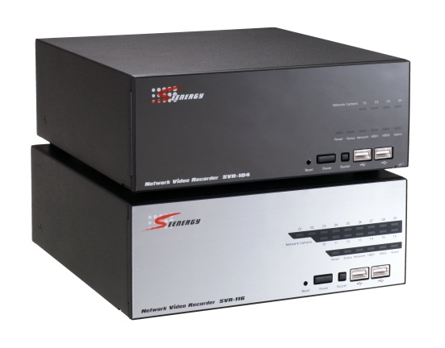
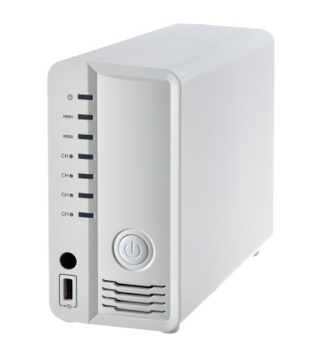
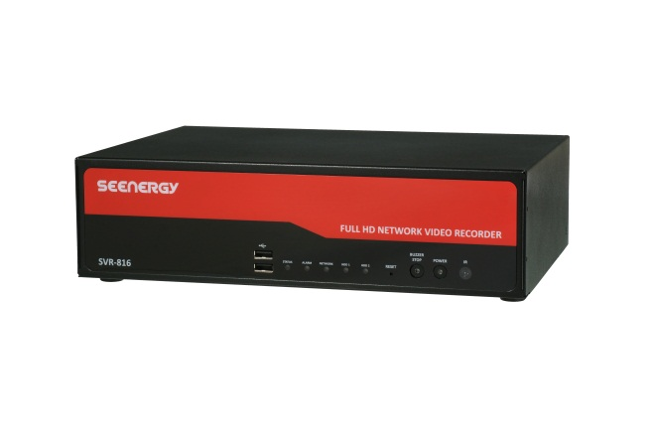
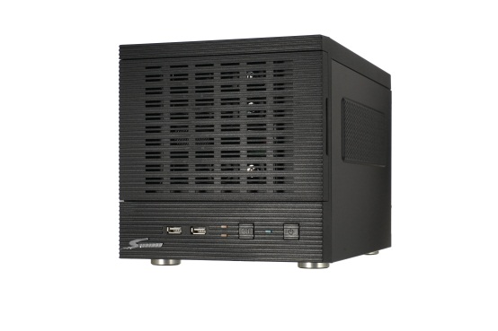
IP surveillance
embedded system solution
Network Video Recorder

Slide 19
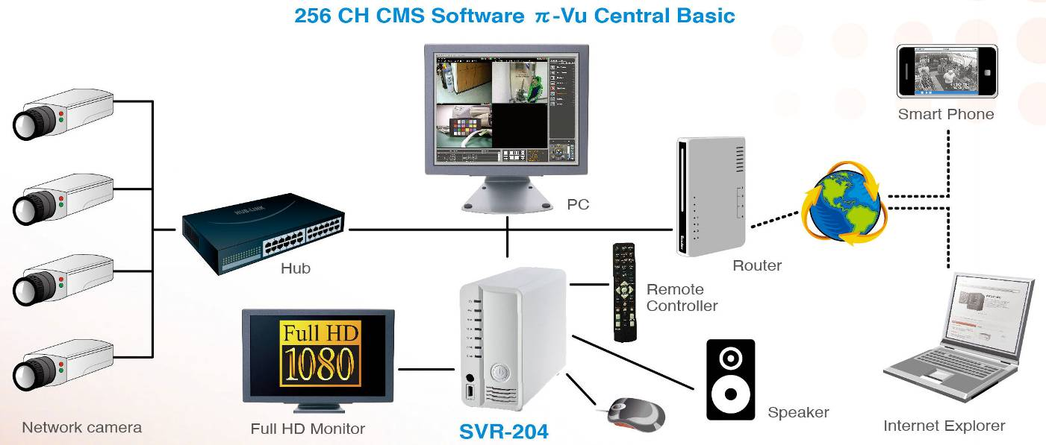
Standalone NVR SVR-204
． Real-time live/playback:
1/4(web), 1 (Local)
． Local display supports multi-standard:
MJPEG, MPEG4 SP@L3,ASP@L5
H.264 high profile@ level 4.1 & 5
． PIP for event video
． Support camera event (MD/DI)
． Mobile device remote access
． AVI backup
． Two way audio
． Linux OS
． 256CH free CMS software
． HDMI & Composite video
output
． Audio line output
． Remote control &
USB mouse
Recording performance
1920X1080 120fps

Slide 20
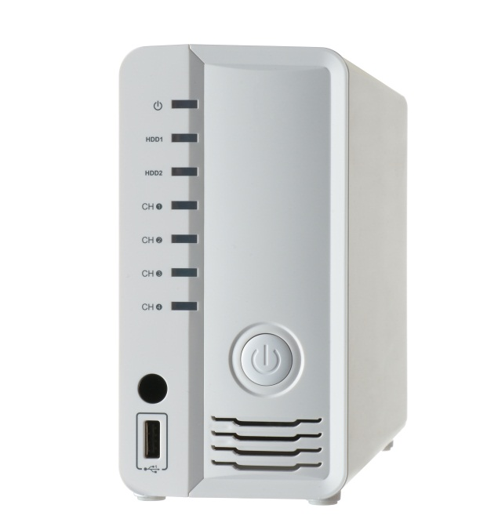
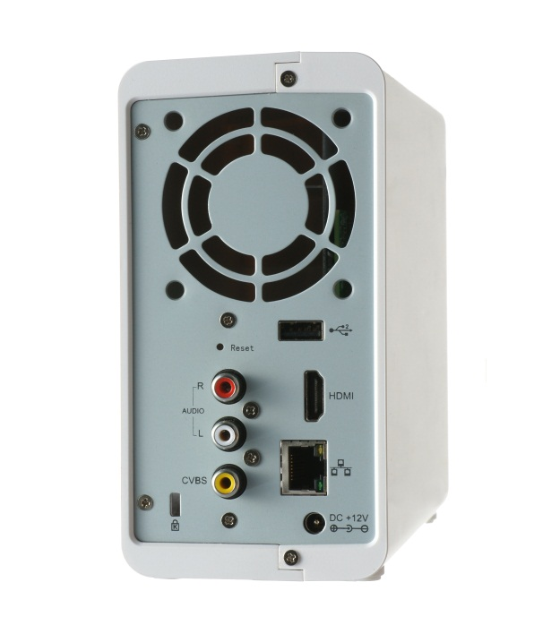
Standalone NVR SVR-204
Power LED
HDD LED
Channel LED
USB
Audio Line out
HDMI video output
IR Receiver
Power
Composite video out
10/100M Ethernet
USB

Slide 21
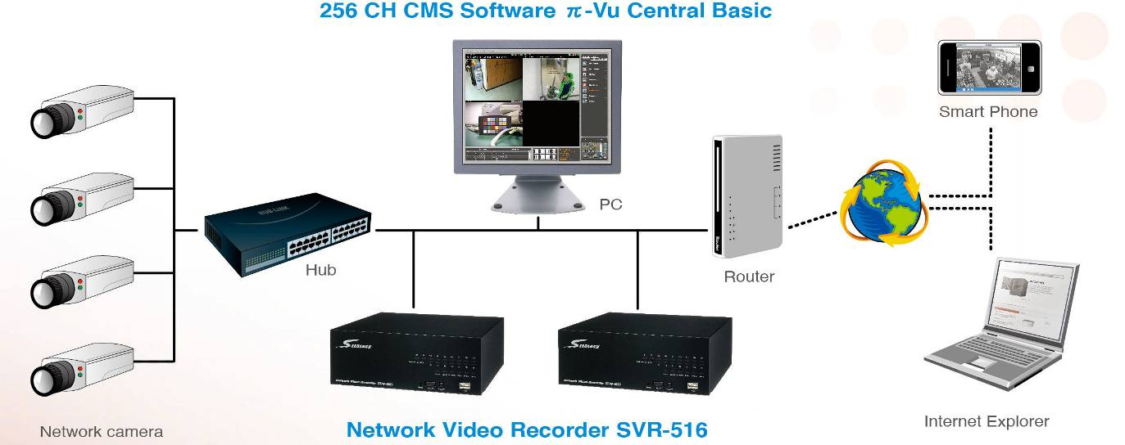
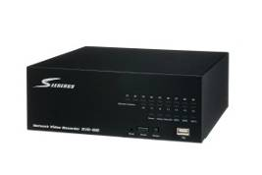
Standalone NVR SVR-500 series
SVR-516
．Support 4/8/16 cameras
． Support MJPEG, MPEG4 and H.264
． Two SATA2 hard disks
． Recorded video/audio can be
played back from web browser
． Digital PTZ
． Web-based E-map Event Alert
． Max. input bandwidth: 80Mbps
． Two-way Audio
． Digital I/O: 8 DI & 4 DO
． Support External UPS
． RS485, RS232 interface
． Support camera event and
DI/DO various types of Alert
． Mobile device remote access
． Linux based operation system
． 256CH free CMS software
． Support DDNS
． Backup file through USB port
Database, AVI file
． Max. throughput: 80Mbps
． HW RAID0/1,E-SATA(SVR-516+)
Recording performance
SVR-516 1280X1024 480fps
SVR-508 1920X1080 240fps
SVR-504 1920X1080 120fps

Slide 22
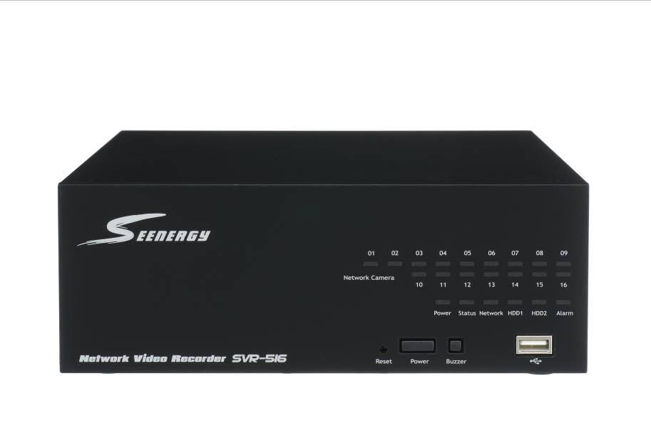
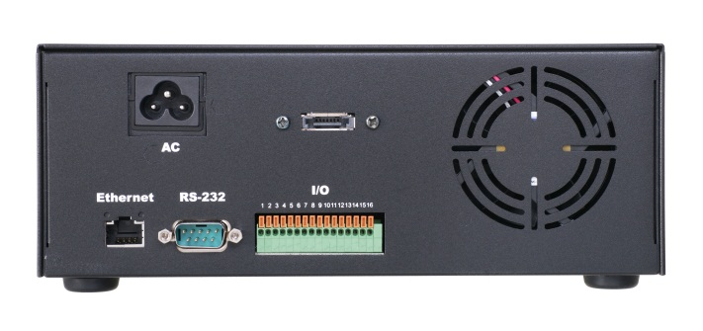


Standalone NVR SVR-516+/516/508/504
100~240VAC
Channel Status LED
E-SATA(SVR-516+)
10/100/1G
Ethernet
RS485
DI x8
Reset
Power
USB
RS232
Buzzer Stop
Power LED
Status LED
Network LED
HDD LED
Alarm LED
DO x4

Slide 23
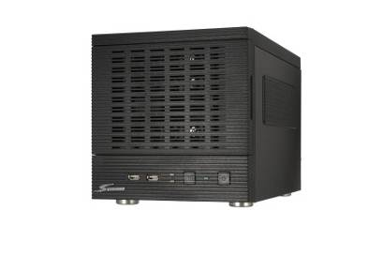
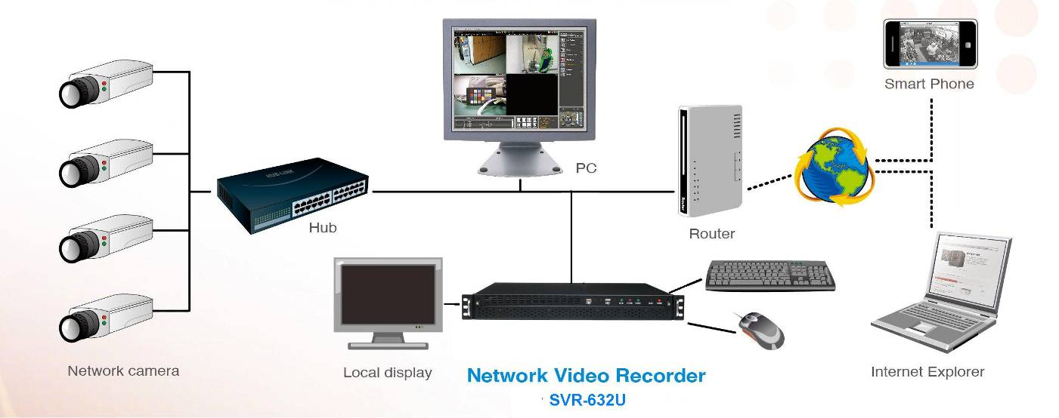
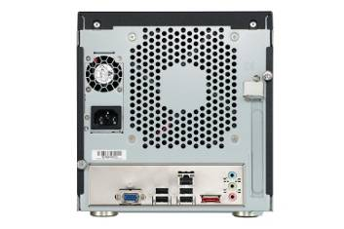
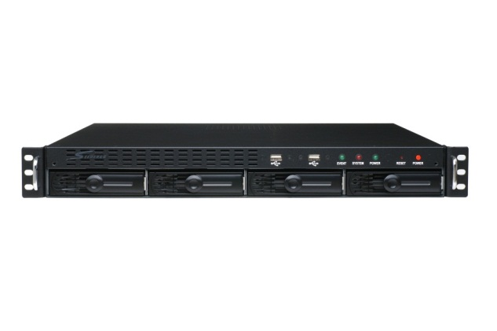
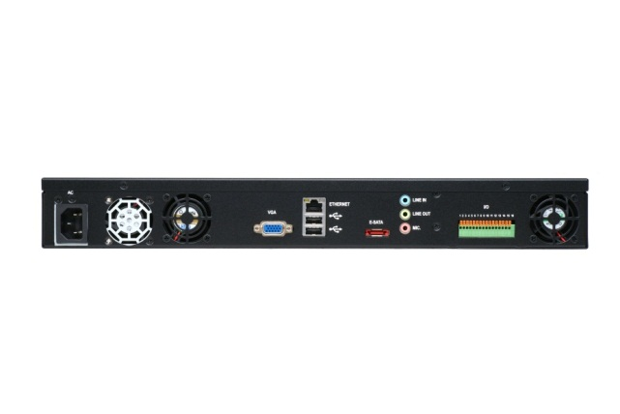
Standalone NVR SVR-632 series
SVR-632
．Support 32 cameras
．Support MJPEG, MPEG4 and H.264
．Two way audio
．Recorded video/audio can be
played back from web browser
．Digital PTZ
． Web-based E-map Event Alert
and Google map
．Support camera event (MD and DI)
． Max. throughput: 200Mbps
． Dual stream
． Mobile device remote access
． Linux OS
． 256CH free CMS software
． Backup database through USB
． Digital I/O
8 DI & 4 DO(SVR-632U)
． VGA video output
． Audio Mic.in, Line in & Line out
． Support USB mouse & keyboard
SVR-632U
Recording performance
1280X1024 960fps
1920X1080 600fps

Slide 24
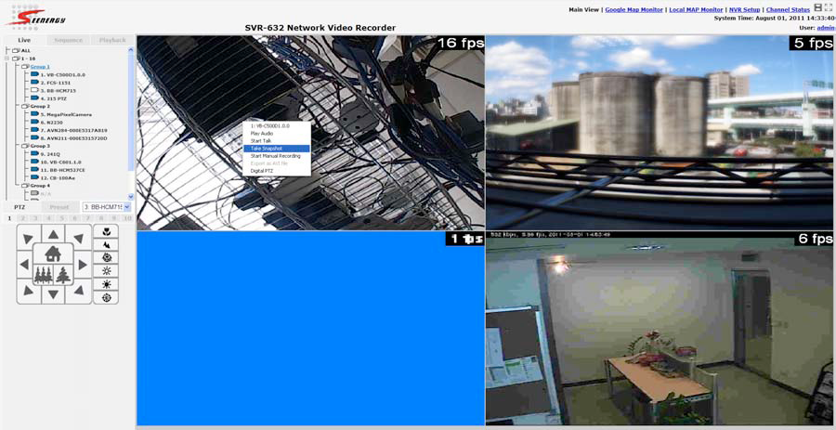
SVR-632 Web Interface
Display ratio and full screen
Change Web UI Display Language
• Retrieve camera’s video stream
• Retrieve camera’s status
• Perform Live Sequence Viewing
• PTZ Control
• video window layout: 1/4/16/36
• Perform PTZ Preset Sequence viewing
• Perform manual recording
• Take snapshot
• Receive audio of a video stream
• Send audio
• Control “Buzzer”
• Change web UI display language

Slide 25
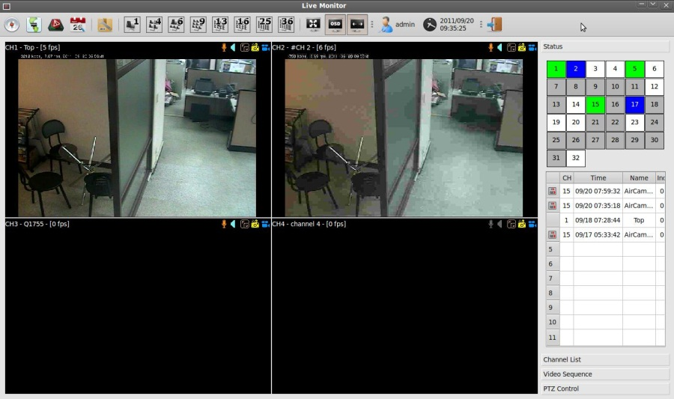
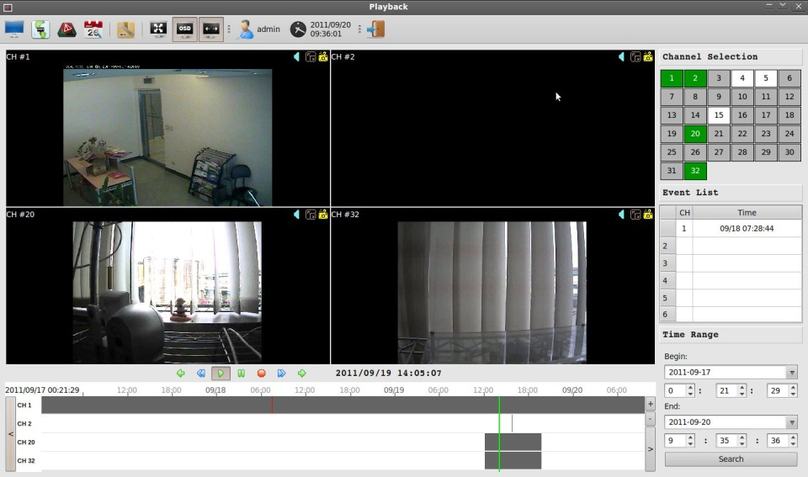
SVR-632 Local display
Live
Playback

Slide 26
About the company
Core Value
Current Product Line
New Product, New Solution for Full HD IP Camera
Test Certificate
Scalable, systematic video surveillance application
Business Alliance Partner

Slide 27

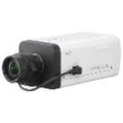


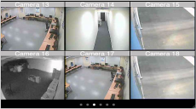
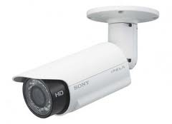





New Product, New Solution for Full HD IP Camera
SVR-800 Series: 8CH/16CH Dual Display IP NVR
Full HD
Monitor
SVR-800
NVR
Hub
Redesigned unified UI
Recording performance
1080p x8,720p x16
80Mbps
Configuration: web, local
Live/playback: web, local
Camera Auto setup
Client software
-ipad/iphone/android
-256CH CMS software
Multi-stream with dynamic display
DSP platform
USB2.0 for external device
Mouse, keyboard, Joystick
Network: RJ 45 (Giga LAN)
IO: 8DI/4 DO
Video: VGA/HDMI
Audio: MIC-in, line-in and line-out
2-4 bays (Hardware RAID),4TB/bay
E-SATA: Max. 8TB
•Local Video Display
-Compression MJPEG/MPEG-4 Part 2/H.264 baseline,
main, high profile
-Resolution 5Mp/3Mp/ Full HD/MegaPixel/FD1/CIF/QCIF
-Max. decoder Frame Rate D1:480fps, 720p:360fps, 1080p:150fps
-Split window 1x1,2x2,3x3,4x4(SVR-816)
-Max. resolution limitation: 5Mp x1
-Dual monitor
-Live:20CH (Live 16CH+SEQ 4CH), Live 16CH+playback 4CH

Slide 28



New Product, New Solution for Full HD IP Camera
SVR-800 Series: 8CH/16CH Dual Display IP NVR
TI DM8168
ARM® Cortex™-A8 Core
TMS320C674x Floating-Point VLIW DSP
3 Programmable High-Definition Video Image Co-processing Engines
Model | channel | HDD(4TB) | RAID
SVR-808 | 8 | 2 | X
SVR-816 | 16 | 2 | X
SVR-816+ | 16 | 2 | RAID0/1
SVR-816U | 16 | 4+eSATA | RAID0/1/5
USB
Power Switch
Turn off buzzer
IR receiver
(backup, mouse, keyboard)
System status
Alarm
Network status
HDD status
VGA/HDMI
Dual monitor
1G Ethernet
Audio Line input/output
Mic. input

Slide 29











New Product, New Solution for Full HD IP Camera
SVR-800 Series: 8CH/16CH Dual Display IP NVR
SVR-800
NVR
Smart Phone
Live video (JPEG)
Remote access
Live view
320x240
Recording
1920x1080
Live view
640x480
1920x1080
640x480
320x240
Hub
Router
Internet
Internet Explorer
Live, Playback (video streaming)
Camera setup
Resolution
Function
Strream1
1920x1080
Live/Rec
Support Multi-Stream
Stream 2
1280x720
Live/Rec
Stream 3
640x480
Live/Rec
iPhone/iPad client software
Live, Playback (video streaming)
Stream 4
320x240
Remote
Network camera

Slide 30

New Product, New Solution for Full HD IP Camera
SVR-800 Series: 8CH/16CH Dual Display IP NVR
640x480
Dynamic Display
Display real-time video on split screen
640x480
1280x1024
1280x1024
SVR-800
NVR
1920x1080
Network camera
Get video steam with different resolution from network camera
1920x1080
* Works with compatible multi-stream cameras only

Slide 31
New Product, New Solution for Full HD IP Camera
SVR-800 Series: 8CH/16CH Dual Display IP NVR
 | 8CH | 16CH
Max. live video frame rate | 240fps@720p30, 120fps@1080p30, 80fps@3MP Max. 5MP, Support 1080p60 | 480fps@D1 30, 360fps@720p30, 150fps@1080p30 Max. 5MP Support 1080p60
Recording + above Local display | 240fps @ 1080p, 4Mbps/CH, total 8CH 120fps @ 3MP, 6Mbps/CH, total 8CH | 480fps @ 1080p, 4Mbps/CH, total 16CH

Slide 32






New Product, New Solution for Full HD IP Camera
SVD-832 Video Decoder, Video Wall Application
DSP platform
Redesigned unified UI
32CH (management), Live:16CH, playback:1CH
Support network camera and SEEnergy NVR
Video wall mode (controlled by 1024CH CMS)
Media player mode (Display NVR video)
Multi-stream with dynamic display
USB2.0 for external device, Mouse, keyboard, Joystick
Network: RJ 45 (Giga LAN)
Video output: VGA/HDMI , dual moitor
Audio I/O: MIC-in, line-in and line-out
Video format :MJPEG/MPEG-4 Part 2/H.264 baseline, main, high profile
Resolution 5Mp/3Mp/ Full HD/MegaPixel/ FD1/CIF/QCIF
Max. decoder Frame Rate D1:480fps, 720p:360fps, 1080p:120fps
Split window 1x1,2x2,3x3,4x4
Max. resolution limitation: 5Mp x1
SVD-832
CMS software
control
Video stream
Network camera
NVR

Slide 33







New Product, New Solution for Full HD IP Camera
SVD-832 Video Decoder, Video Wall Application
Audio/Video stream
Network camera
NVR
Control
Audio/Video stream
Network camera
Controlled by 1024CH CMS software
Display live video stream from NVR & camera
CMS
Manage NVR & Video decoder

Slide 34





New Product, New Solution for Full HD IP Camera
SVD-832 Video Decoder, Standalone Mode for NVR/Camera
Control NVR remotely
Display live & playback
Operated by mouse, keyboard, remote controller and joystick
SVD-832
NVR
Audio/Video stream
Media player Mode
Network camera

Slide 35








New Product, New Solution for Full HD IP Camera
PI VU Central 2.0
CMS software Pi-Vu Central 2.0
PC
Hub
Hub
NVR
SVD-832
Network camera
Central control NVR & SVD
Max.1024CH
Support Google Map

Slide 36




New Product, New Solution for Full HD IP Camera
SVR-632S 2U RACK 32CH IP NVR
Recording performance
32CH,1280x1024, 2Mbps
8 bays: 2U housing
4TB x 8
Video output: VGA
Audio IO: Microphone, line in & line out
USB x4
E-SATA x 1 (Max. 8TB)
RAID 0/1/5/10
8DI/4DO
Front Side
Front Side: 8 HDD Tray
Back Side: 8DI/4DO
Side View

Slide 37
About the company
Core Value
Current Product Line
New Product, New Solution for Full HD IP Camera
Safety Certificate
Scalable, systematic video surveillance application
Business Alliance Partner

Slide 38


Safety Certificate
Approved EU Directive: 89/336/EEC, 92/31/EEC, 93/68/EEC, 2004/108/C EMC
C-tick: AS/NZS CISPR 22:2006
EMI: EN 55022/2006+A1/2007-> EN 61000-3-2/2006, EN61000-3-3/2008
EMS: EN55024/1998+A1/2001+A2/2003-> EN61000-4-2/2009
EN61000-4-3/2006+A1/2008, EN61000-4/4/2004, EN61000-4/5/2006
EN61000-4-6/2009, EN61000-4-8/1993+A1/2001, EN61000-4-11/2004
Approved 47CFR, Part 2 and Part 15 of FCC Rules

Slide 39
About the company
Core Value
Current Product Line
New Product, New Solution for Full HD IP Camera
Safety Certificate
Scalable, systematic video surveillance application
Business Alliance Partner

Slide 40

Scalable, systematic video surveillance application

Slide 41


Scalable, systematic video surveillance application
Remote Backup
Pi-VU Smartbackup
Central management
Pi-Vu central
SDK Integration
Remote Access
Mobile viewer
Video wall
SVD-832
NVR
Network camera

Slide 42


Slide 43

Scalable, systematic video surveillance application
Added Value: NVR Media Player
Media database file and AVI file can be
Played by SEEnergy NVR media player

Slide 44

Scalable, systematic video surveillance application Added Value: IP Surveillance Platform API/SDK
Pi-Vu Pro client SDK
Pi-Vu Pro/SVR CMS SDK

Slide 45
About the company
Core Value
Current Product Line
New Product, New Solution for Full HD IP Camera
Safety Certificate
Scalable, systematic video surveillance application
Business Alliance Partner

Slide 46

























Valuable Partnership
．Partner of major brand network camera/video server(40 brands)
． Support Onvif protocol
． Ability to support wide range of network camera
． Long term relationship

Slide 47
Thanks for Your Attention, for more details, welcome to contact
SEEnergy Corp.
4F, No. 61, DongXing Road, Sinyi District 110
Taipei, Taiwan
Tel: +886 2 87681518
Fax: +886 2 87878560
E-Mail: sales@seenergy.com.tw

