Slide 1
Network Video Recorder
Performance

Slide 2
NVR Performance Index
Total Throughput rate
Local display performance
Remote access capability
Camera brand compatibility
Future expansion

Slide 3
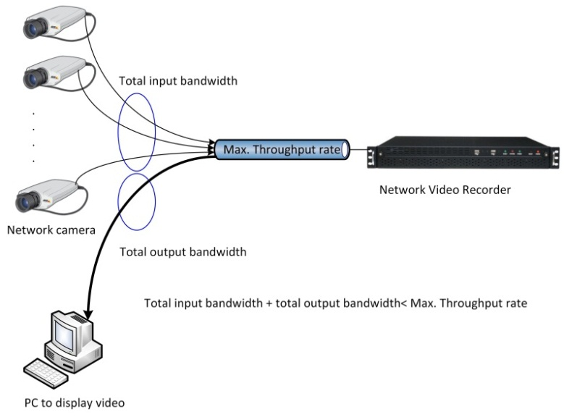
Throughput Rate
The video data is encapsulated and transmitted by the camera on the network, and it needs to be de-capsulated and interpreted by the NVR before it can be used. If an user on the same or remote network requested such data from the NVR, it could be live video stream, or data that was already stored on the NVR’s HDD. The NVR then needs to re-package these data for transmission. Such action is done by the CPU inside the NVR, and the amount of data can be transmitted every second, which is normally described as “throughput rate”, is determined by the processing power of the CPU.

Slide 4
Throughput Rate
NVR has higher throughput rate, means:
  Higher Input bitrate : camera quantity, total bit rate, picture quality and FPS
  Higher Output bitrate: Capability of video streaming for remote
  If NVR throughput rate is 100Mbps, bitrate of each camera is 6Mbps(30fps@1920x1080), the recording performance is 16 channel, real time
  If NVR runs both recording and remote access, the recording throughput rate will become 50Mps. The recording performance is 8CH(30fps) or 16CH(15fps).

Slide 5
Local display performance
NVR receives compressed digital video/audio data from network camera, whether display live video or video archive on local monitor, the digital data need to be decompressed by NVR
NVR has better video decoder performance means:
  Total FPS is higher:
    150fps@1920x1080,80fps@3Mp,…
  Support high resolution video stream, such as 5Mp,3Mp
    If NVR performance is limited, can not decode higher resolution than 1920x1080.
  Can display multi channels with high resolution, such as 16CH 1080p, 8CH 3Mp
    If NVR performance is limited, need use dual stream with special
  Can display multi-channel with different video format and resolution:
    For example:16CH, each channel isn’t limited by video format(MJPEG/MPEG4/H.264) and resolution(CIF, VGA, D1, 720P, 1080P)
  Support 1080p 60fps
  Dual monitor output
    Display video on both monitors
    For example: 1st monitor: 16CH for live, 2nd monitor: 4CH for playback

Slide 6
Remote Access Capability
Internet is popular, except feature of local display, playback and recording. Remote access and configuration is key feature of NVR.
NVR needs support
  Set up and control NVR through browser, don’t need install extra application software on PC.
  Multiple live and playback video streams can be accessed through internet. NVR has higher performance means it can support more video stream for remote access, for example: 48 live video streams and 16 playback video streams.

Slide 7
Compatibility of Camera
Each camera manufacturers have different ways to control system, get status, notify event and setup multi-stream of video.
Though there is a standard - Onvif protocol: But compatibility is still limited by camera hardware and technical ability of manufacturer.
NVR can support more brands, means it has higher flexible for application, is not limited to special cameras.

Slide 8
Future Expansion
NVR can be used as a standalone equipment. Application software increase solution value of NVR. In addition to native applications, the need to expand the system with application software applications, increase system ROI
NVR supports more variety of application software, system expandability is the stronger
  management: central management software is used to manage multiple NVR, such as, a NVR manage 16CH, through 16 NVR management software, we can expand the system for up to 256.
  Remote Backup: Using remote backup server software to store data backed up regularly.

Slide 9
NVR Hardware Platform
Main hardware of :
  X86(Intel i7/i5), ARM+DSP, SOC
OS: Linux

Slide 10
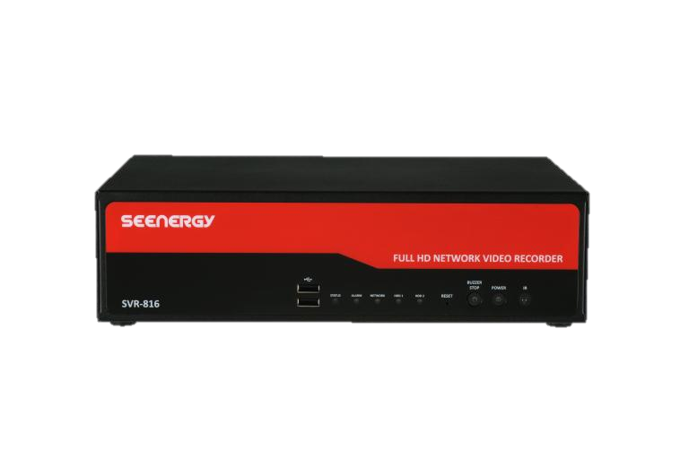
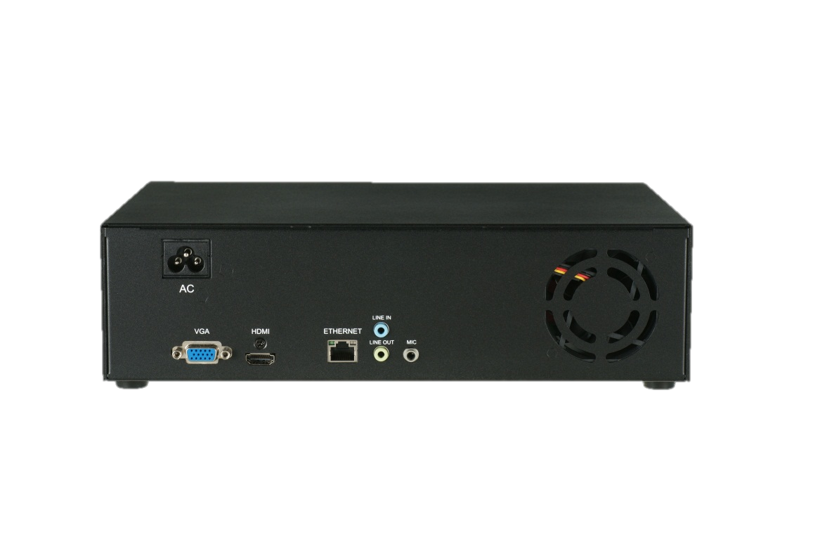
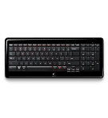


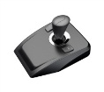
SVR-800 series
  TI DM8168
  ARM® Cortex™-A8 Core
  TMS320C674x Floating-Point VLIW DSP
  3 Programmable High-Definition Video Image Co-processing Engines
Model | channel | HDD(4TB) | RAID
SVR-808 | 8 | 2 | X
SVR-816 | 16 | 2 | X
SVR-816+ | 16 | 2 | RAID0/1
SVR-816U | 16 | 4+eSATA | RAID0/1/5
FW Upgrade
USB
Power Switch
Turn off buzzer
IR receiver
(backup, mouse, keyboard)
System status
Alarm
Network status
HDD status
VGA/HDMI
Dual monitor
1G Ethernet
Audio Line input/output
Mic. input

Slide 11
SVR-800 Throughput rate
Recording mode:80Mbps
Recording and local display are operated simultaneously:
  SVR-808 recording performance:
    240fps @ 1080p, 4Mbps/CH, total 8CH
    120fps @ 3MP, 6Mbps/CH, total 8CH
  SVR-816 recording performance
    480fps@1080p, 3Mbps/CH, total 16CH

Slide 12
SVR-800 Local Display performance
SVR-808 local display
  240fps@720p30,120fps@1080p30,80fps@3MP
  Supports 5Mp,1080p60
  Max. display capability: 5Mp X2 & 3Mp x10
SVR-816
  480fps@D1 30,360fps@720p30,150fps@1080p30
  Supports 5Mp,1080p60
  Max. display capability: 5Mp X1及1080p x19
Dual monitor
Display multi-channels with different video
format and resolution
5Mp
H.264
VGA
MJPEG
720p
H.264
1920X1080
H.264
1280X1024
MPEG4

Slide 13
SVR-800 remote access capability
Max. video session: 68
  Display + playback
  Flexible system resources usage
  Sharing session between local and remote access
    For example: 16 session for local display, 52 sessions for remote access
  Sharing session between remote live view and playback
    For example: Without local display, each remote site access 2 live and 2 playback sessions. Max. 17 remote sites can connect NVR.

Slide 14






















SVR-800 Camera Compatibility
Support Onvif & 40 brands network camera manufacturers.
Camera auto-search
Configuration of camera video parameter
Support multi-stream and two way audio
Alarm notification of camera

Slide 15

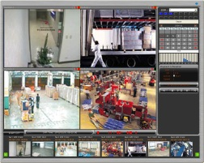
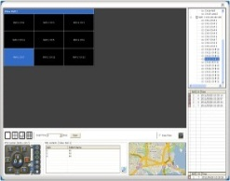
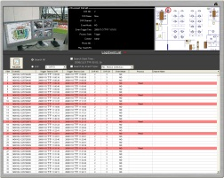
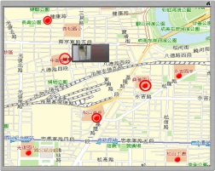
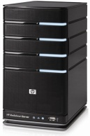
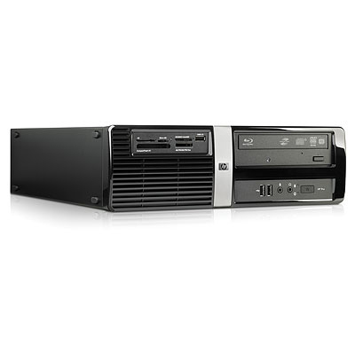


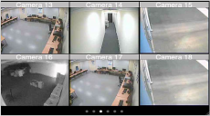
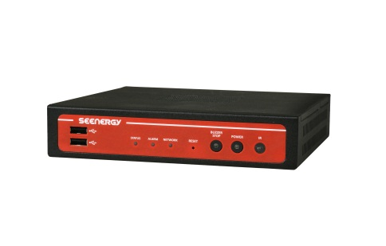
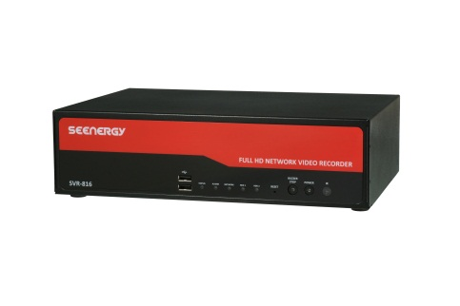

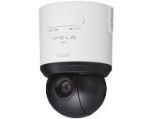
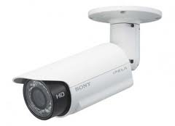
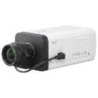
SVR-800 Future Expansion
Remote Backup
Pi-VU Smartbackup
Central management
Pi-Vu central
SDK Integration
Remote Access
Mobile viewer
Video wall
SVD-832
NVR
Network camera

Slide 16
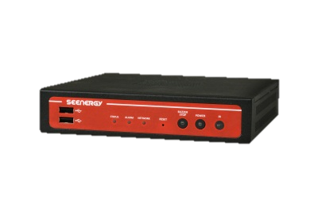
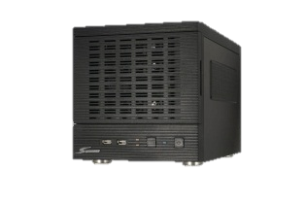
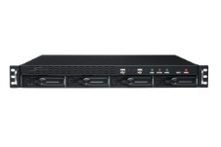
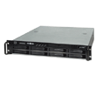
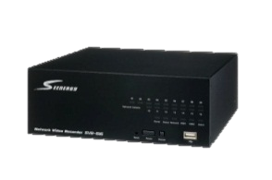
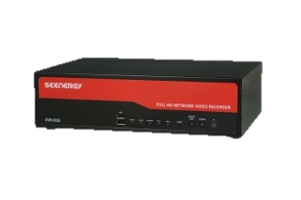
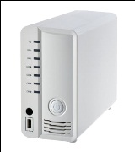
NVR Total Solution
Central Management-Pi-Vu central
Remote Backup-Pi-Vu Smart Backup
Mobile Access-Mobile Viewer
Video Decoder-SVD-832
NVR Server
NVR with Local Display
SVR-632:32CH, 4 bay
SVR-632U:32CH, 4 bay
SVR-632S:32CH, 8 bay
Enterprise
SVR-504:4CH
SVR-508:8CH
SVR-516:16CH
SVR-516+: 16CH & RAID0/1
SVR-808:8CH
SVR-816:16CH
SVR-816+: 16CH & RAID0/1
SVR-816U: 16CH, 4 bay, RAID0/1/5
Small office
Entry
level
SVR-204

