Slide 1


Xarina Series Product Announcement
Notes:
1

Slide 2
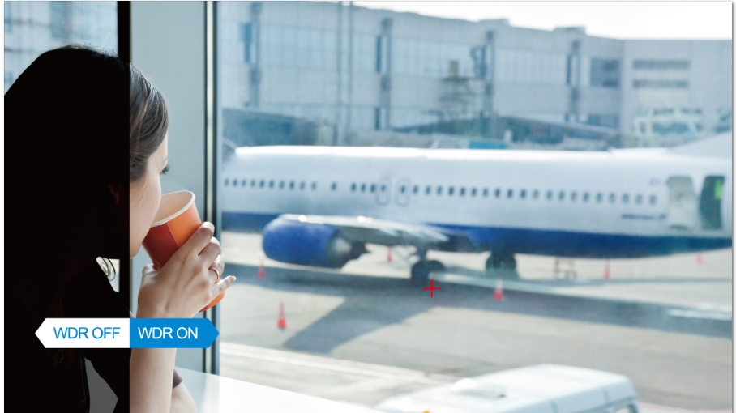
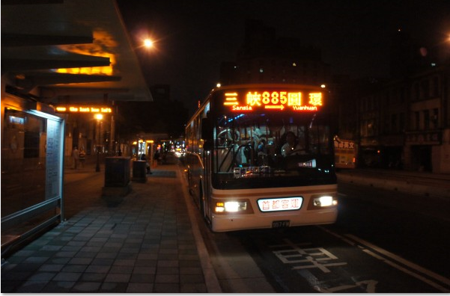
Product Position
A Series of Cameras to Provide Clear Details in Extreme Environment & Special Applications
Extreme Bright
Night View
Notes:
2

Slide 3
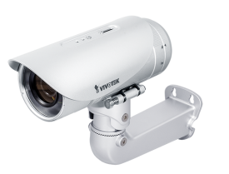
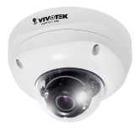
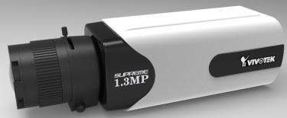
Product Introduction
Sony Xarina Platform with 1.3 & 2-Megapixel CMOS Sensor
30 fps @ 1.3MP & 2MP
3 ~ 10mm(FD835(6)5) & 3~9mm(IP835(6)5), Vari-focal,
Remote focus, P-Iris Lens
WDR Pro & WDR Pro II ( up to 140dB)
Supreme Night Visibility
Built-in IR illuminators with Smart IR technology, effective up to 30 meters
3D Noise Reduction
Notes:
3

Slide 4
Product Features & Advantages
30 fps @1.3MP & 2MP
60fps @ 1.3MP & 2MP with limitation
WDR Pro (100dB) & WDR Pro II (140dB)
Supreme Night Visibility
Built-in IR illuminators with Smart IR technology, effective up to 30 meters
3D Noise Reduction
Video Rotation
Snapshoot Focus ( Box only)
ABF support ( Box only)
Two-Way audio
Notes:
4
We planned three phases here to implement different features on our 3mp cameras .

Slide 5
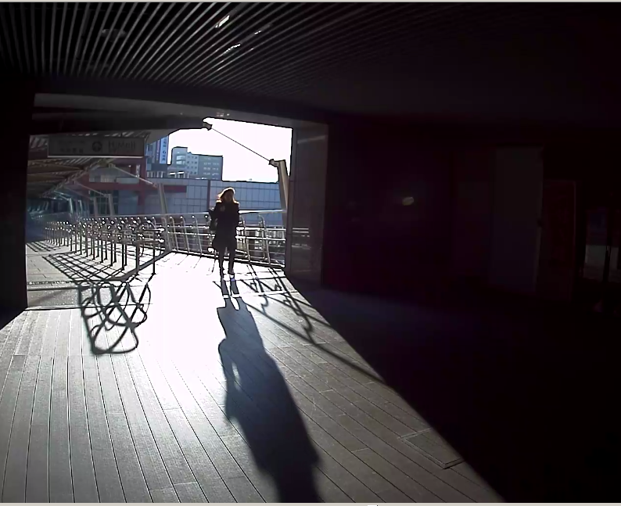
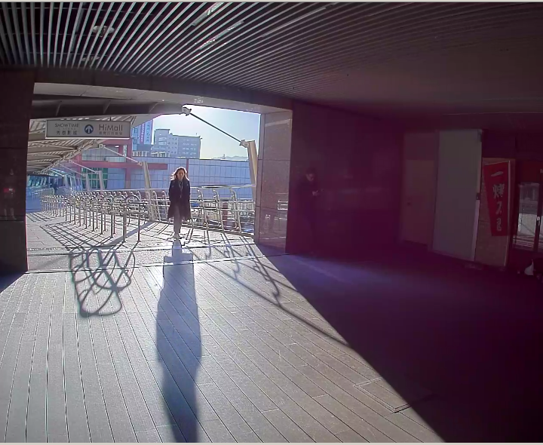
WDR Pro II
WDR Off
WDR Pro II
Notes:
5
Highlight Benefit of 60fps

Slide 6
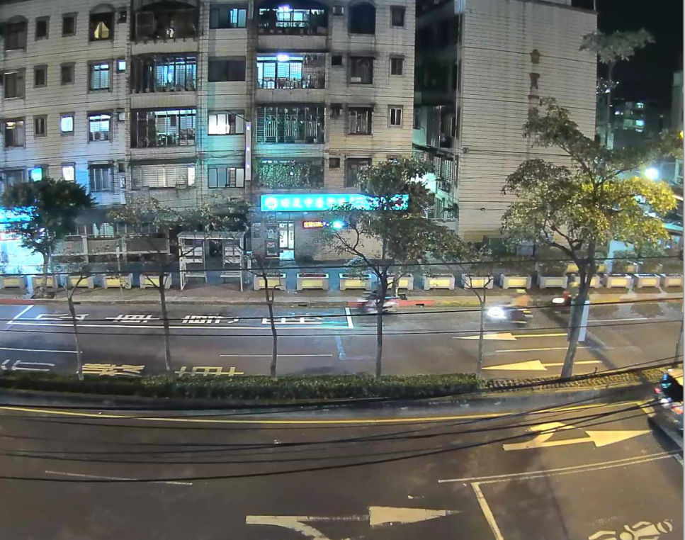
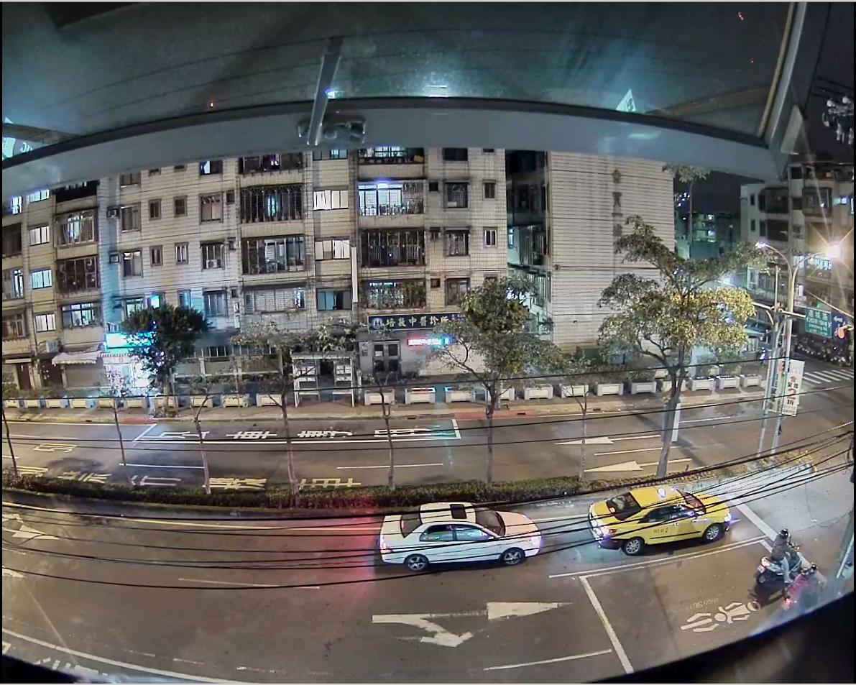
Extreme Night Visibility
Sony
VM601
VIVOTEK
FD8355EHV
Notes:
6
Highlight Benefit of 60fps

Slide 7
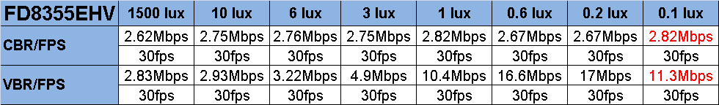
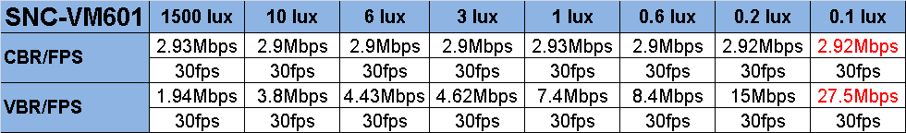
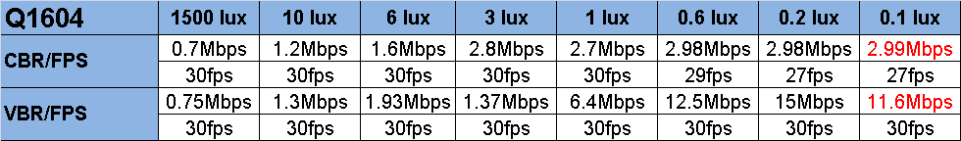
Bitrate Comparison
Camera Settings
Codec : H.264 / 1280*800
CBR: 3Mbps
VBR: FD8355EHV Quality 57, Q=28
SNC-VM601 Quality 6, Q=28
Q1604 Q=28
Notes:
7
Highlight Benefit of 60fps

Slide 8

Product Specification – 1.3MP
 | IP8355EH | FD8355EHV | IP8155HP
Lens | 3~9mm Remote Focus P-Iris | 3~10mm Remote Focus P-Iris | 2.8~8mm Remote Focus P-Iris
Max. Frame Rate | 30fps @ 1.3MP
IR Illuminator Range | 30M Smart IR | 30M Smart IR | -
Minimum Illumination | 0.07 Lux | 0.08 Lux | TBD
WDR | WDR Pro II ( 140dB)
DNR | 3DNR
Casing | IP67 | IP66, IK10 | -
Power & IO | PoE, AC24V, DC12C, Audio in/out, DI*1, DO*1, Analog out, RJ45 |  | PoE, AC24V, DC12C, Audio in/out, DI*3, DO*1, Analog out, RJ45
Operating Temperature | -50℃~50℃ (PoE: -20℃~50℃) | -50℃~50℃ (PoE: -20℃~50℃) | -20℃~50℃

Slide 9
Product Specification– 2MP
 | IP8365EH | FD8365EHV | IP8165HP
Lens | 3~9mm Remote Focus P-Iris | 3~10mm Remote Focus P-Iris | 2.8~8mm Remote Focus P-Iris
Max. Frame Rate | 30fps @ 2MP
IR Illuminator Range | 30M Smart IR | 20M Smart IR | -
Minimum Illumination | 0.39 Lux | 0.42 Lux | TBD
WDR | WDR PRO (100db)
DNR | 3DNR
Casing | IP66 | IP66, IK10 | -
Power & I/O | PoE, AC24V, DC12C, Audio in/out, DI*1, DO*1, Analog out, RJ45 |  | PoE, AC24V, DC12C, Audio in/out, DI*3, DO*1, Analog out, RJ45
Operating Temperature | -50℃~50℃ (PoE: -20℃~50℃) | -50℃~50℃ (PoE: -20℃~50℃) | -20℃~50℃

Slide 10
Product Position
Product
Product Introduction
Product Features & Advantages
Product Specification
Target Application
Product Comparison
Product Information
Notes:
10
Position: Providing Superb & Detailed Image
Product : specs & features
Target Applications
Price
Place : project type ( list potential applications) ?
Promotion ?

Slide 11
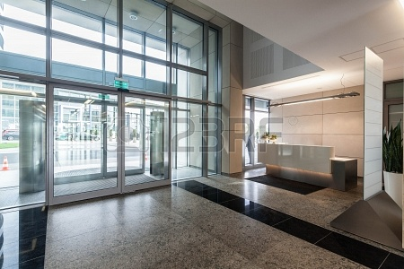
Banking
Value | Crime prevention Evidence provider
Location | Entrance
Features | Benefits
WDR Pro II | 140dB WDR provide more details in front of bank counters
IR Illuminators | Provide 24/7 day and night security for 24h monitor
SD/SDHC/SDXC recording | Save bandwidth System Redundancy
Notes:
11

Slide 12
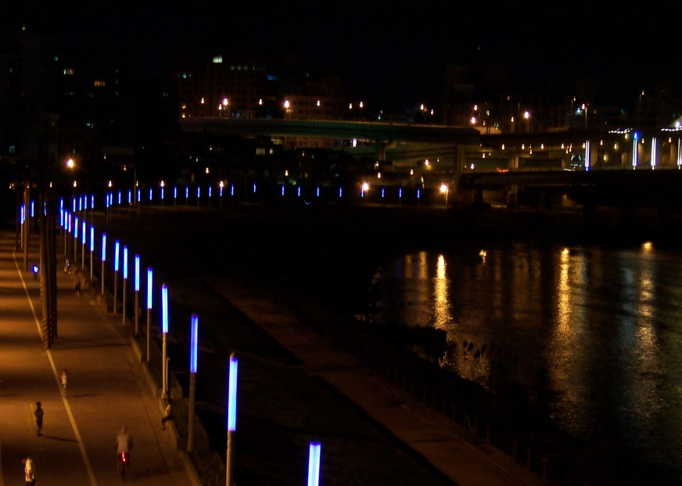
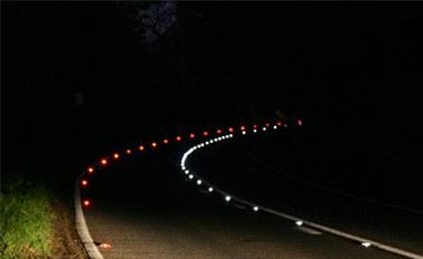
Night View
Value | Road way Security Community Surveillance
Location | Roadway Crossroad
Features | Benefits
Low Lux | Provide detail image at night
3DNR | Eliminate the noise for night visibility with lower bandwidth
IR Illuminators | Provide 24/7 day and night security
SD/SDHC/SDXC recording | Save bandwidth System Redundancy
IP66, IP67 | Weather-proof housing for outdoor application
Notes:
12

Slide 13

Traffic Monitoring
Value | Vehicle tracking Accident monitoring Violation monitoring
Location | Highways Crossroads
Features | Benefits
60fps * | Provide more details for fast moving objects
Snapshoot Focus* | Provide more convenient way to adjust focus while installing on the highway
IR Illuminators | Provide 24/7 day and night security
3D Noise Reduction | Better night visibility Lower bandwidth
* Will be available in the 2nd phase for project based demand
Notes:
13

Slide 14
Product Position
Product
Product Introduction
Product Features & Advantages
Product Specification
Target Application
Competitor Comparison
Product Information
Notes:
14
Position: Providing Superb & Detailed Image
Product : specs & features
Target Applications
Price
Place : project type ( list potential applications) ?
Promotion ?

Slide 15


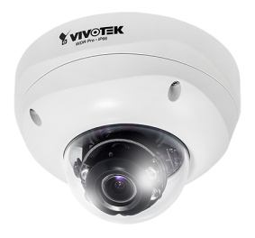
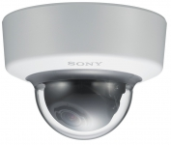
Competitor Comparison – Dome
 | 1.3MP |  | 2MP
 | FD8355EH | SNC-VM601 SNC-VM601B | FD8365EH | SNC-VM631
IR Illuminator Range | 30m | - | 20m | -
Lens | 3-10mm Remote Focus P-iris | 3-9mm Easy focus DC-iris | 3-10mm Remote Focus P-iiris | 3-9mm Easy focus DC-iris
Max. Frame Rate | 30fps | 60fps (VM601B) 30fps (VM601) | 30fps | 60fps
Minimum Illumination | 0.08lux @1/30 s | 0.05 lux @1/30s (AGC on) | 0.42 lux @1/30s | 0.1 lux @1/30s (AGC on)
WDR | 140dB | 130dB | 100dB | 90dB
DNR | 3DNR | XDNR | 3DNR | XDNR
Operating Temperature | -50°C ~ 50°C | -10°C ~ 50°C | -50°C ~ 50°C | -10°C ~ 50°C
Housing | IP66, IK10 | IK10 | IP66, IK10 | IK10
I/O | RJ-45 Audio in/out, AV output AC 24V / DC 12V DI/DO *1 | RJ45, AV out, Phono jack*1, , Sensor in*2, Alarm out*2, Line in/ out ( mini Jack), | RJ-45 Audio in/out, AV output AC 24V / DC 12V DI/DO *1 | RJ45, AV out, Phono jack*1, , Sensor in*2, Alarm out*2, Line in/ out ( mini Jack),
Notes:
Check Samsung Bullet 競品分析 report

Slide 16

Competitor Comparison – Dome
 | 2MP
 | FD8365EH | XA series
IR Illuminator Range | 20m | 25m
Lens | 3-10mm Remote Focus P-iiris | 3-9mm DC-iris Manual Vari-Focal | 3-9mm DC-iris Motorized | 3-9mm DC-iris 3x Zoom Lens
Max. Frame Rate | 30fps | 30fps
Minimum Illumination | 0.42 lux @1/30s | -
WDR | 100dB | 96dB
DNR | 3DNR | 3DNR
Operating Temperature | -50°C ~ 50°C | -10°C ~ 50°C
Housing | IP66, IK10 | IP66
I/O | RJ-45 Audio in/out, AV output AC 24V / DC 12V DI/DO *1 | RJ-45 for Network/PoE connection Alarm:4 of 9 Pin Terminal Block Power:4 Pin Terminal Block (male) Analog Video:1.0 Vp-p / 75 Ω, BNC Audio: 5 of 9 Pin Terminal Block
Notes:
Check Samsung Bullet 競品分析 report

Slide 17
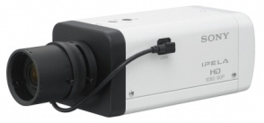
Competitor Comparison – Box
 | 1.3MP |  | 2MP
 | IP8155HP | SNC-VB600/ VB600B | IP8165HP | SNC-VB630
IR Illuminator Range | - | - | - | -
Lens | 2.8mm-8mm ABF P-iris | 2.8mm-8mm Easy Focus DC-iris | 2.8mm-8mm ABF P-iris | 2.8mm-8mm Easy Focus DC-iris
Max. Frame Rate | 30fps | VB600: 60fps/ VB600B: 30fps | 30fps | 60fps
Minimum Illumination | TBD | 0.05 lux @ 1/30s (AGC on) | 0.4Lux @1/30s | 0.1 lux @ 1/30s (AGC on)
WDR | 140dB | 130dB | 100dB | 90dB
DNR | 3DNR | XDNR | 3DNR | XDNR
Operating Temperature | -20°C ~ 50°C | -10°C ~ 50°C | -20°C ~ 50°C | -10°C ~ 50°C
I/O | RJ45, DI*3, DO*1, AV out, Audio in/ out | RJ45, Sensor in*2, Alarm out*2, AV out, Audio in/ out | RJ45, DI*3, DO*1, AV out, Audio in/ out | RJ45, Sensor in*2, Alarm out*2, AV out, Audio in/ out
Notes:
Check Samsung Bullet 競品分析 report

Slide 18
Product Position
Product
Product Introduction
Product Features & Advantages
Product Specification
Target Application
Product Comparison
Product Information
Notes:
18
Position: Providing Superb & Detailed Image
Product : specs & features
Target Applications
Price
Place : project type ( list potential applications) ?
Promotion ?

Slide 19
Official Release Schedule
Official Website | IP835(6)5EH: March 31st FD825(6)5EHV: March 31st
Press Release | Mar, 2014
Video (WDR Pro II) | April, 2014

Slide 20
Questions & Backup

Slide 21
Question 2
Q2: There seems to be some limitations on Xarina series products, where to learn this information.
A: There is a link where we summarize the limitations: http://dqa02/projects/dqa-test-1-bugvvtk-xarina/documents
Notes:
21

Slide 22
Backup– Product Features
Phase I
30 fps@ 1.3MP, 30fps@ 2MP
Supreme Night Visibility
WDR Pro II & WDR Pro
Built-in IR illuminators with Smart IR technology, effective up to 30 meters
3D Noise Reduction
Phase II
60fps
Video Rotation
Snapshoot Focus
Notes:
22

Slide 23

Back up – Product Series Schedule
2014 Q1 | 2014 April | 2014 May | 2014 June
60fps
Phase II
IP835(6)5EH
60fps
Video Rotation
Phase II
FD835(6)5EHV
- Snapshoot Focus
- Face Detection
60fps
Video Rotation
Phase II
IP815(6)5HP
Notes:
23

Slide 24

Thank you
for your attention
The End
Notes:
24

