Slide 1


VS8100 Sales Kit
Notes:
1

Slide 2
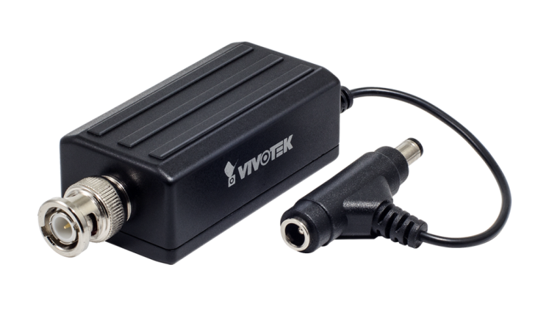
Content
Purpose
Front-end Installation
  Reference Application – Bank, specific for ATM
Back-end Installation
  Reference Application – Retail / Shopping Mall
Redundant Solution
VS8100 & Camera Solution
VIVOTEK Video Management Software

Slide 3
Purpose
VS8100 is designed for small and large analog video cameras, especially where an IP network connection is already settled.
Its small size also makes it ideal for use in discreet surveillance applications, such as in retail stores and banks, home surveillance, etc.
From the free APP- iViewer, you can access your cameras anywhere / anytime from your mobile phone or PAD (Android / iOS).

Slide 4






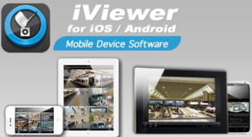
Front-end Installation
Existing Analog System
Analog PTZ
DVR
Network Switch
PC
Microphone
Migrated Analog PTZ w/ VS8100
Analog PTZ
PC
VS8100
Network Switch
Microphone
iViewer
Coax Cable
LAN / Internet
RS-485
Power Cable
Audio In

Slide 5
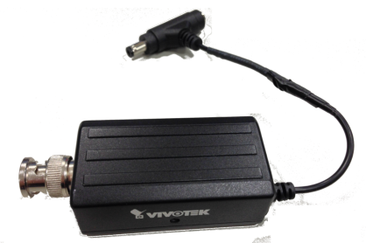
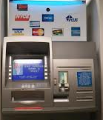
Reference Application - ATM
Suggested solution:
VS8100
Original Analog Camera
w/ DC12V power input
Features:
D1 resolution @ 25/30fps
De-interlace
DC 12V power sharing w/ analog camera
Ultra-mini Design
Benefits:
Combined with existing CCTV Camera &
Its original structures, transforming its analog signal into digital at front-end installation.
Notes:
5

Slide 6
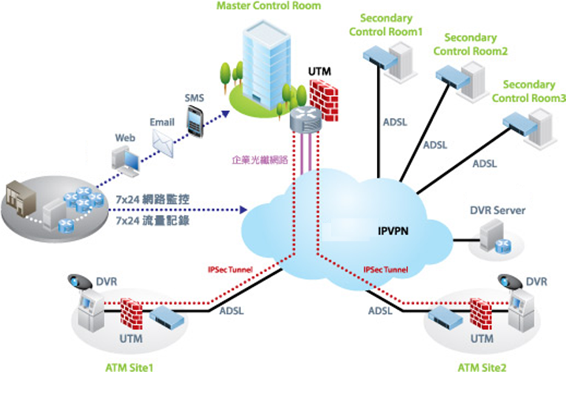
Network Structure of ATM - Bank

Slide 7



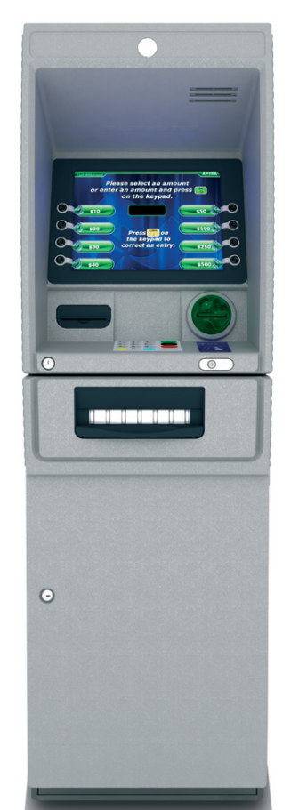
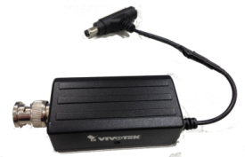
Reference Application – Bank, specific for ATM
Analog Camera, that most of ATM machine vendor provide as an option.
CMS/VMS: eg.
Milestone, Genetec, VAST, ONVIF compliant system
Video to additional DVR or built-in DVR on the ATM machine. Can be the trigger to enable ATM machine.
Video can only be the evidence after event happened.
Built-in / optional: Network switch or hub for data transmission.
Original framework
Value added framework with Video Server.
Use BNC splitter, video can be stored locally on DVR, and connect to Video Server
With same network connection, video / event can be transmitted to monitoring center immediately.

Slide 8
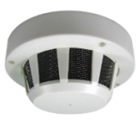

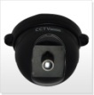
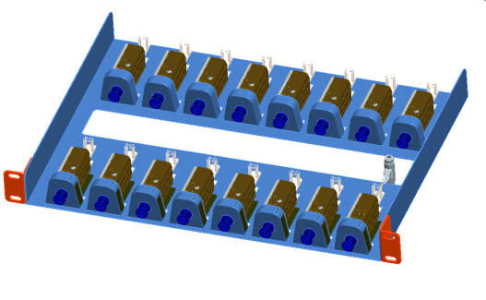
Back-end Installation
Existing Analog System
Analog PTZ
DVR
Network Switch
PC
Analog Camera
Microphone
Migrated Analog Cameras w/ VS8100 + Rack-mount kit
Analog PTZ
PC w/ VIVOTEK ST7501
Network Switch
VS8100 Rack-mount kit
Analog Camera
Microphone
iViewer
Coax Cable
LAN / Internet
RS-485
Power Cable
Audio In

Slide 9
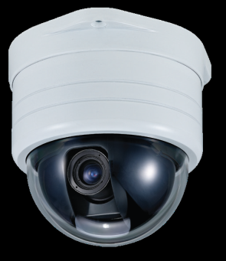
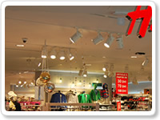
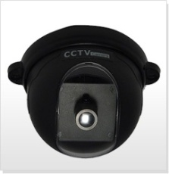
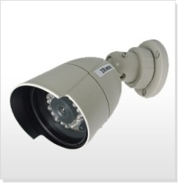

Reference Application – Retail / Shopping Mall
Suggested solution:
VS8100
Original Analog Camera
w/ DC12V power input
Or Analog PTZ w/ RS-485 protocol
Features:
D1 resolution @ 25/30fps
De-interlace
DC 12V power sharing w/ analog camera
RS-485 for PTZ control
Ultra-mini Design
Benefits:
Lower cost solution to enhance higher performance analog cameras, eg. PTZ cameras or low light camera. From analog to digital technology without scrapping your investments in an analog system.
Notes:
9

Slide 10

Redundant Solution
Existing Analog System
Analog PTZ
DVR
Network Switch
PC
Analog Camera
Microphone
Analog System w/ VS8100 + Rack-mount Kit
Analog PTZ
Network Switch
PC w/ VIVOTEK ST751
BNC Splitter
VS8100 Rack-mount kit
iViewer
Analog Camera
Microphone
DVR
Coax Cable
LAN / Internet
RS-485
Power Cable
Audio In

Slide 11
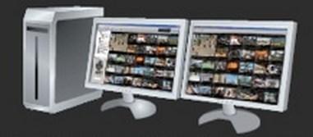












VIVOTEK VS8100 & Camera Solution
Analog PTZ
Network Switch
VS8100 Rack-mount kit
PC w/ VIVOTEK ST7501
Analog Camera
Microphone
VIVOTEK VAST
Network Switch
PC w/ VIVOTEK ST7501
VIVOTEK Network Cameras
Coax Cable
LAN / Internet
RS-485
Power Cable
Audio In

Slide 12
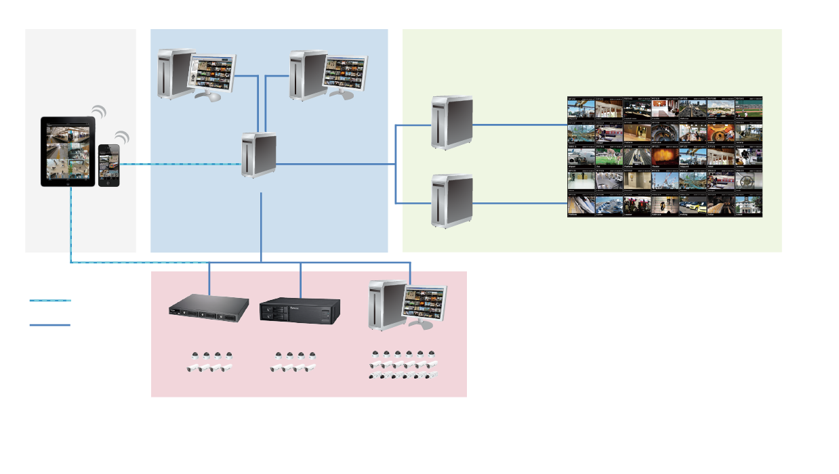


VIVOTEK Video Management Software
Central Management Software
Free-standard Recording Software ST7501
VAST Matrix
Recipient 1
VAST
LiveClient
VAST
Playback
VAST Matrix
Recipient 2
Mobile Viewer
VAST
Server
CMS Server (VAST)
Virtual Matrix
Video Wall
Recording Server
(Sub-Station)
NR Series
ND Series
ST7501
VIVOTEK
Network Cameras

Slide 13

Thank you
for your attention
The End
Notes:
13

